Slide 1
Primer on Radiosonde
Tracking and Chasing
Presented to SCARS September 16, 2023

Slide 2
Topics
What is a radiosonde?
Why would a ham be interested in them?
What is minimum I need to track?
What Info can I get while tracking?
What do I need to chase/recover?
What can I do with a recovered radiosonde?

Slide 3
What is a Radiosonde?
High Altitude Balloon (HAB) with Sensor package attached
Sensors include GPS, temp, humidity, sometimes pressure
Routine launches at 0z & 12z daily from NWC on OU campus
Transmits Horus (4FSK) on 404.2MHz typically (400-406MHZ)
Balloon typically bursts ~115k ft, then parachute deploys
Flight lasts 2 to 3 ½ hours; Landing point varies dramatically
Landing points are predicted ahead of time, but are approximate
NWS suggests you recycle or dispose properly

Slide 4
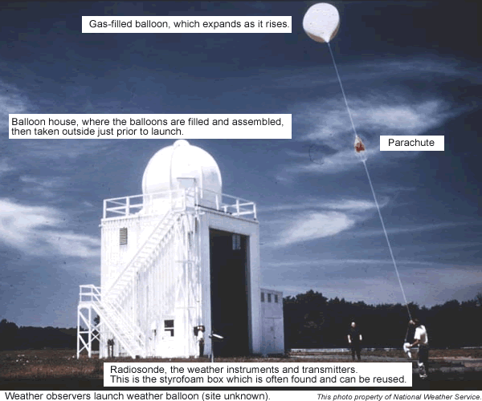
Radiosonde Balloon House

Slide 5

Radiosonde Balloon Popped

Slide 6
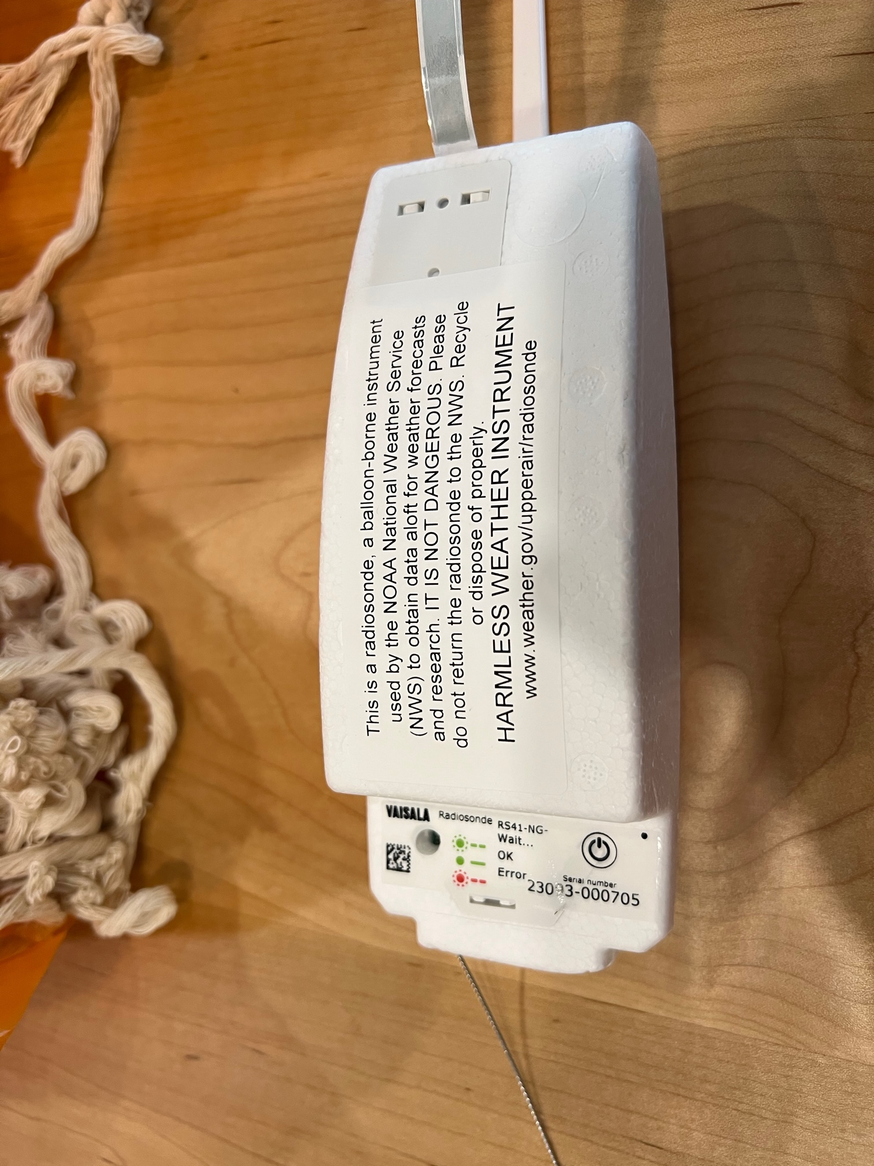
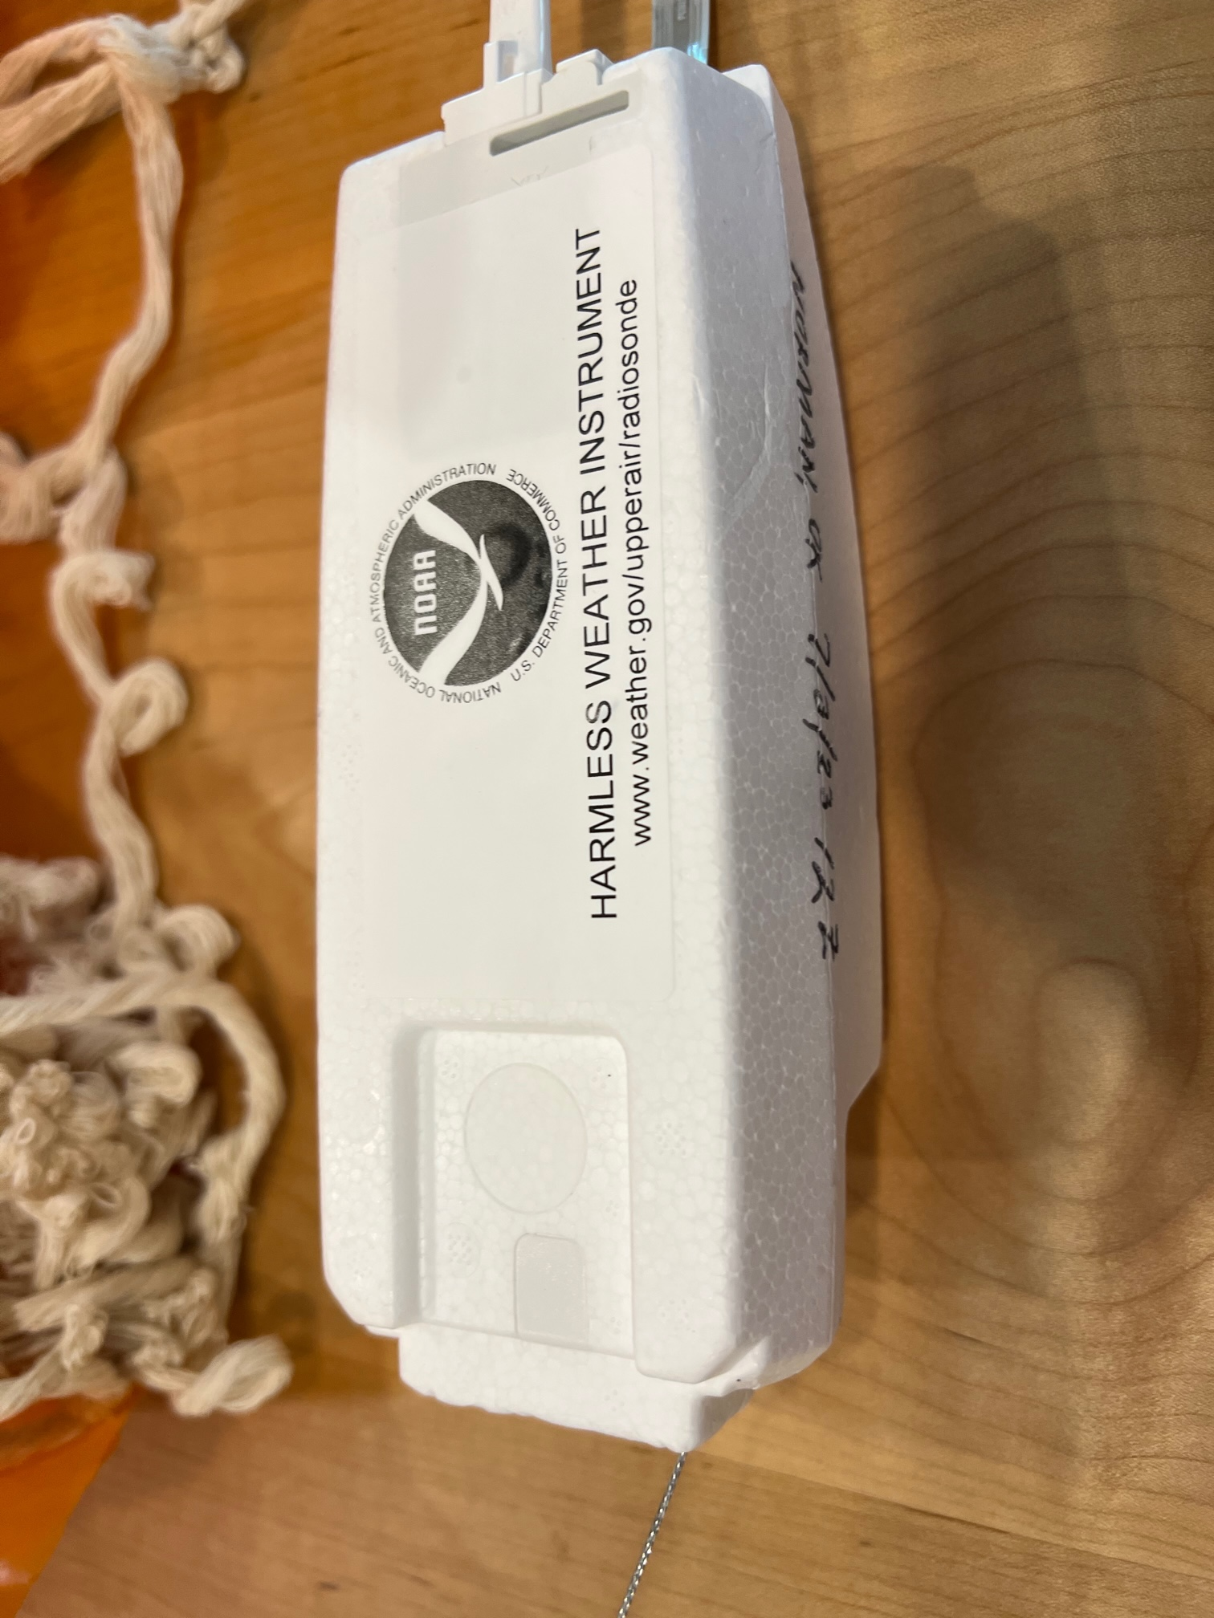
Common RadioSonde (RS41-NG)

Slide 7
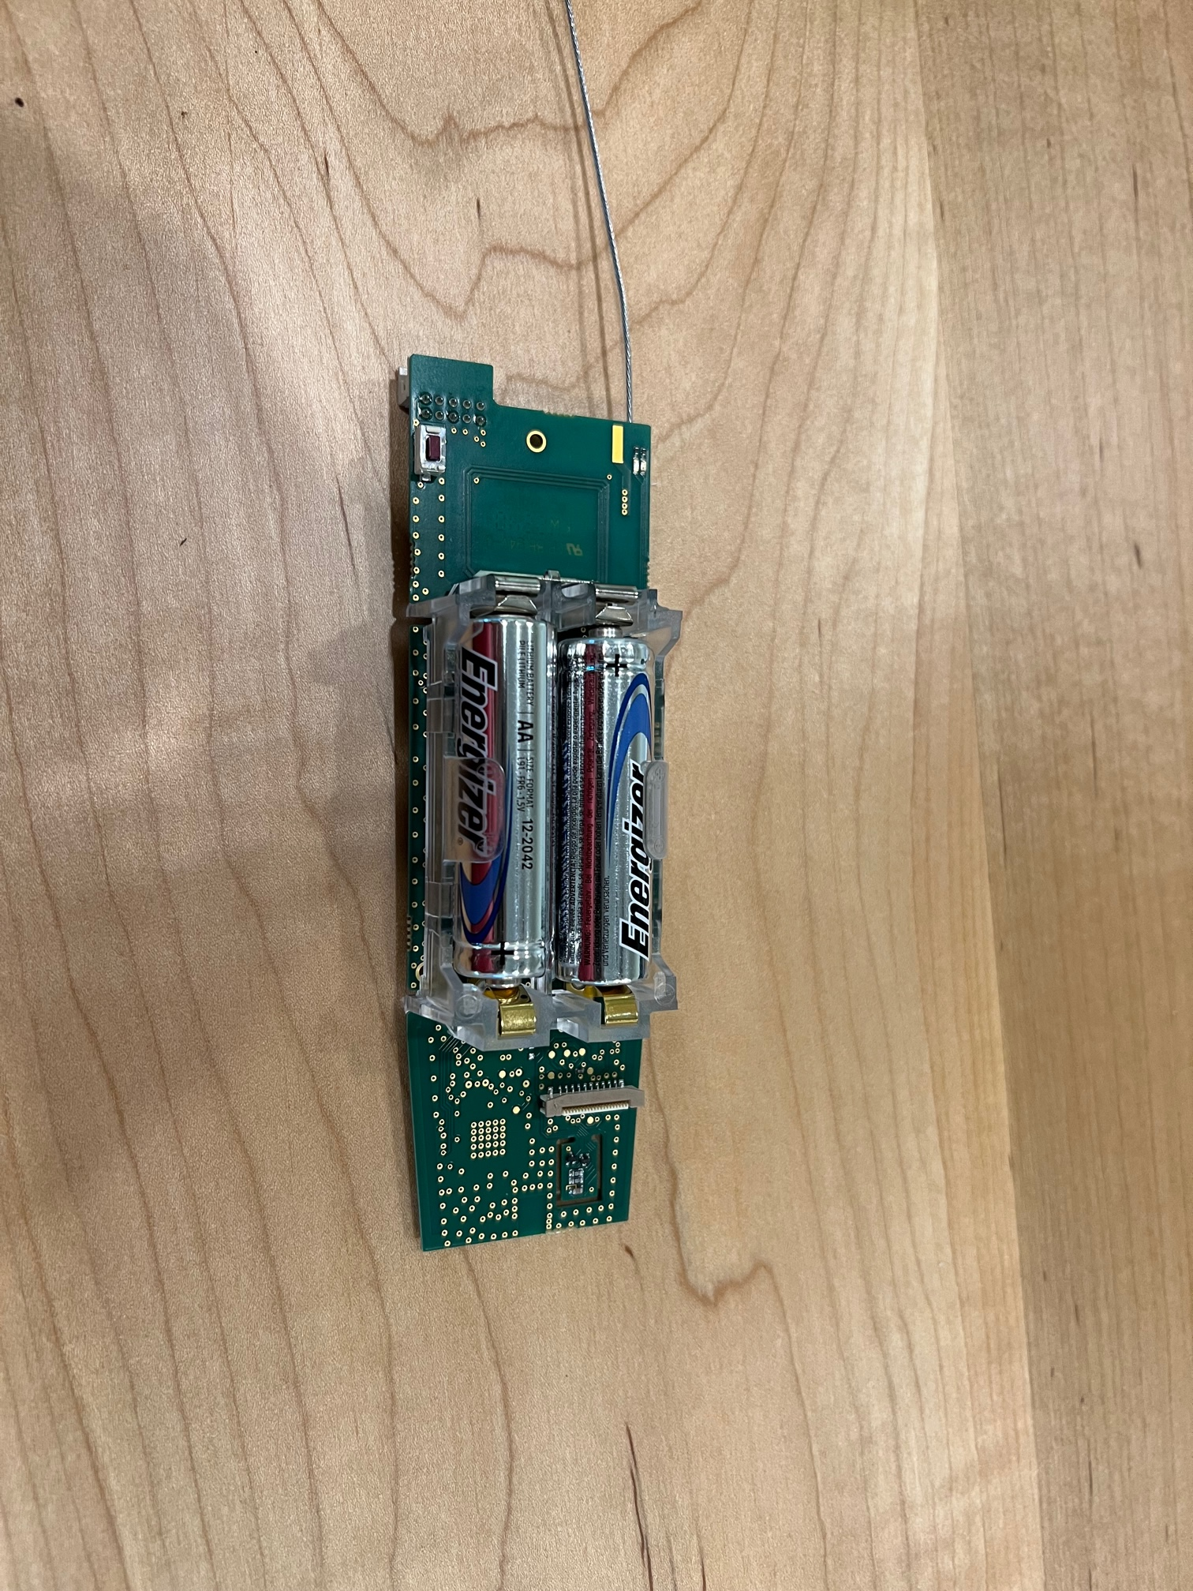
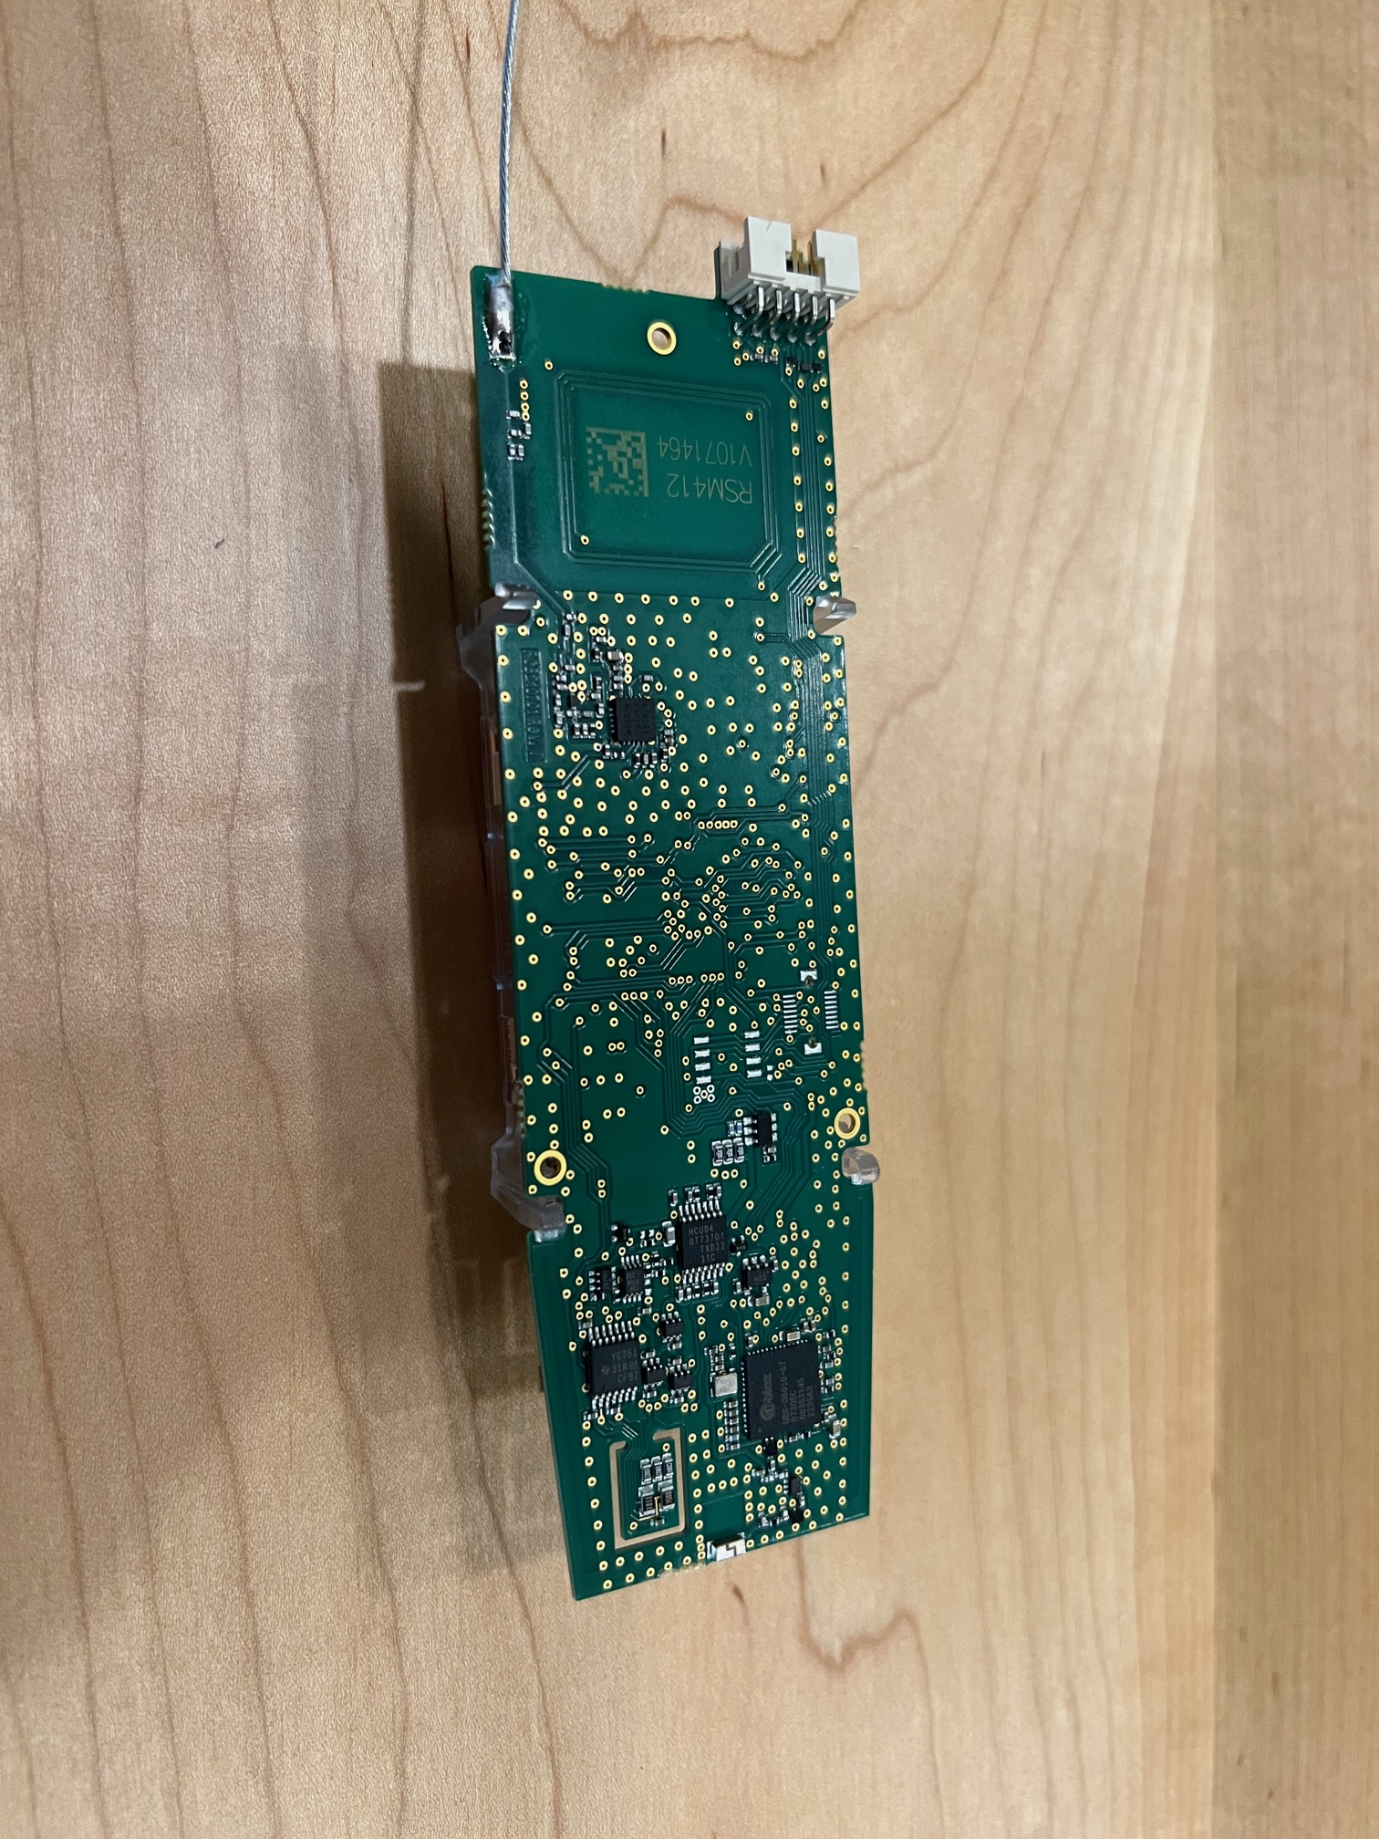
RadioSonde (RS41-NG) Internal

Slide 8
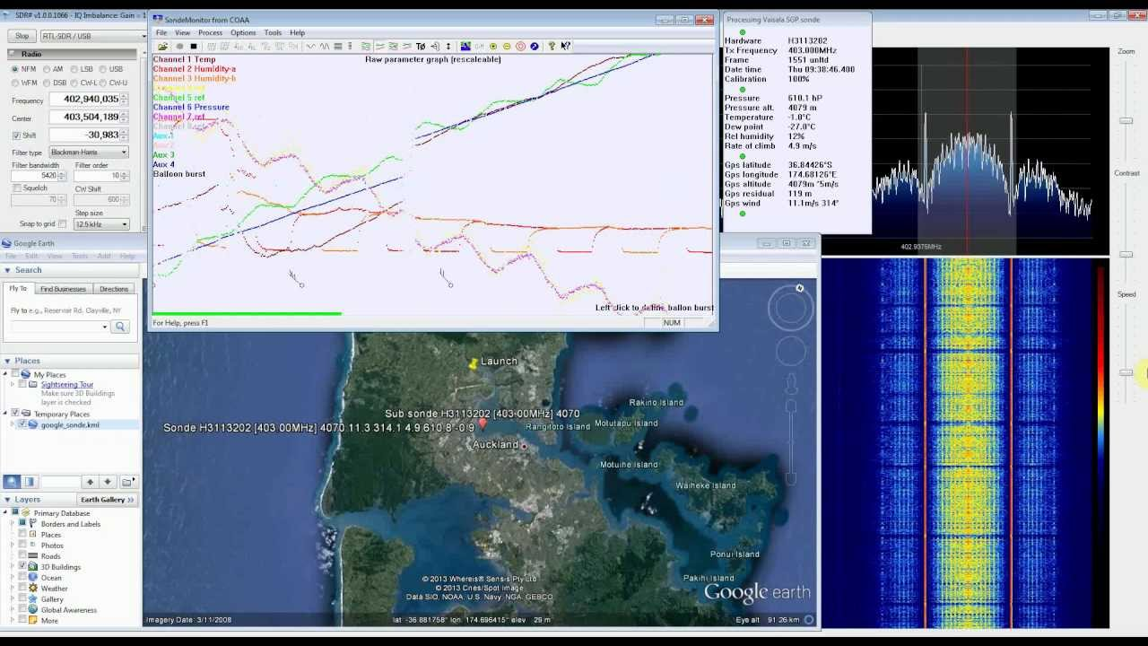
Radiosonde Decode with SDR#

Slide 9
Why would a Ham be Interested?
Possible Gateway into High Altitude or Pico Ballooning
Opportunity to practice for a fox hunt
Learn about how these data feed into weather prediction
Help kids/grandkids with possible school (STEM) projects
If retrieved:
Can reprogram for ham frequencies, relaunch!
Use as a GPS tracker, mini weather station, or “Fox”
… and ...

Slide 10
FREE*
… it’s...
* Fuel and ER Charges Not Included :)

Slide 11
Why would a Ham be Interested?
What do we get for FREE?
Launch ready package containing:
CPU: 32bit STM32F100C8 MCU
24 MHz, 64kB flash
GPS: UBLOX UBX-6010
TX: SiLabs SI4032, max power ~60mw, Tuned to 70cm
External I2C bus and UART serial port
Powered by 2 AA batteries

Slide 12
What is Minimum I Need to Track?
PC or smart device (phone, tablet) with a browser
Go to http://sondehub.org and scroll/zoom to our area
Click on ‘sonde of interest
Details of that ‘sonde appear in column on left
Examples in following slides

Slide 13
What Info can I get while tracking?
If during launch (up to 2-3 hours after 6am or 6pm), can see
Location of radiosonde as a balloon icon or parachute icon
recent track and future (predicted) track
Target icon (predicted landing site is updated periodically)
Optionally display Skewed-T plot and other data charts
List of other currently active radiosondes
Location of chase cars (if they chose to be visible)
Otherwise, can see historical data from past launches

Slide 14
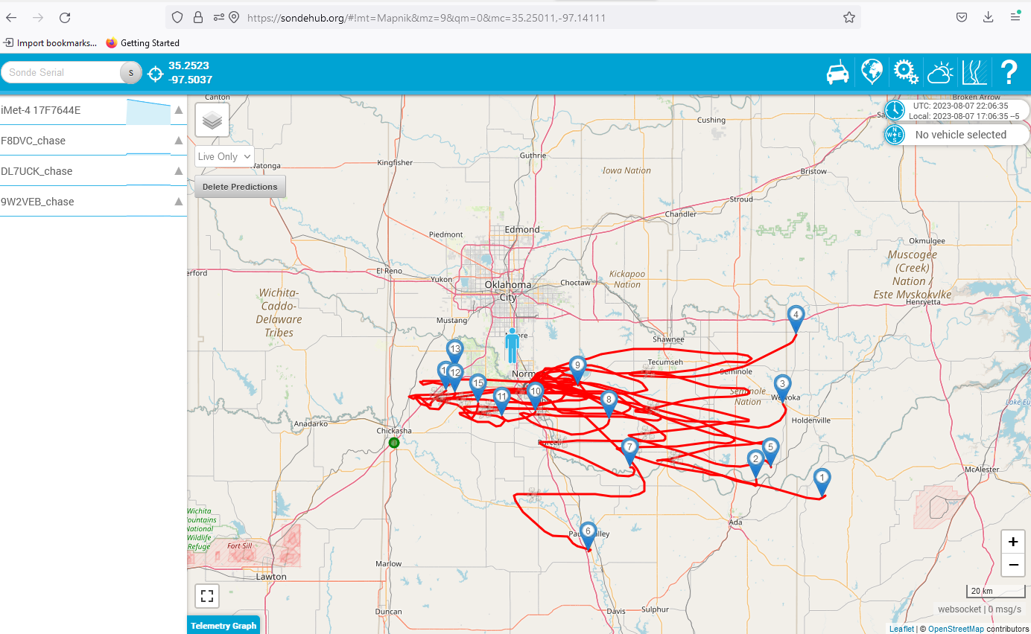
Sondehub 7 Day Prediction

Slide 15
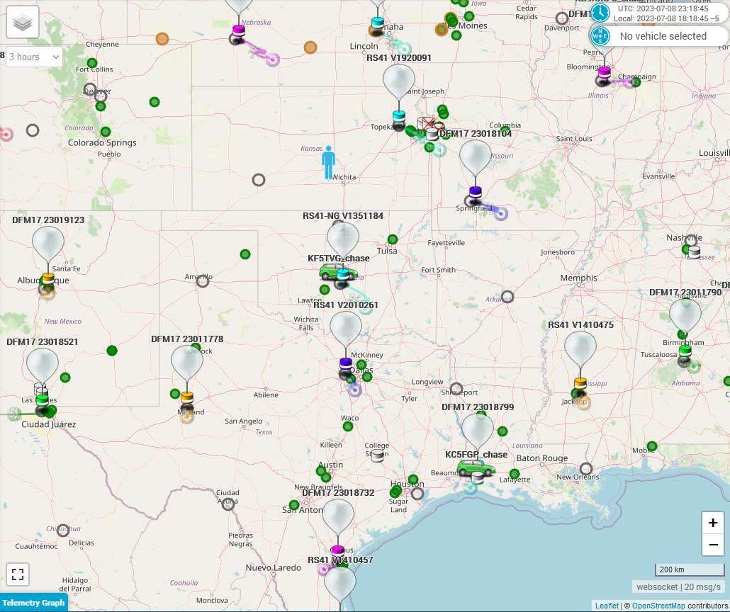
Regional sondehub Live Map

Slide 16
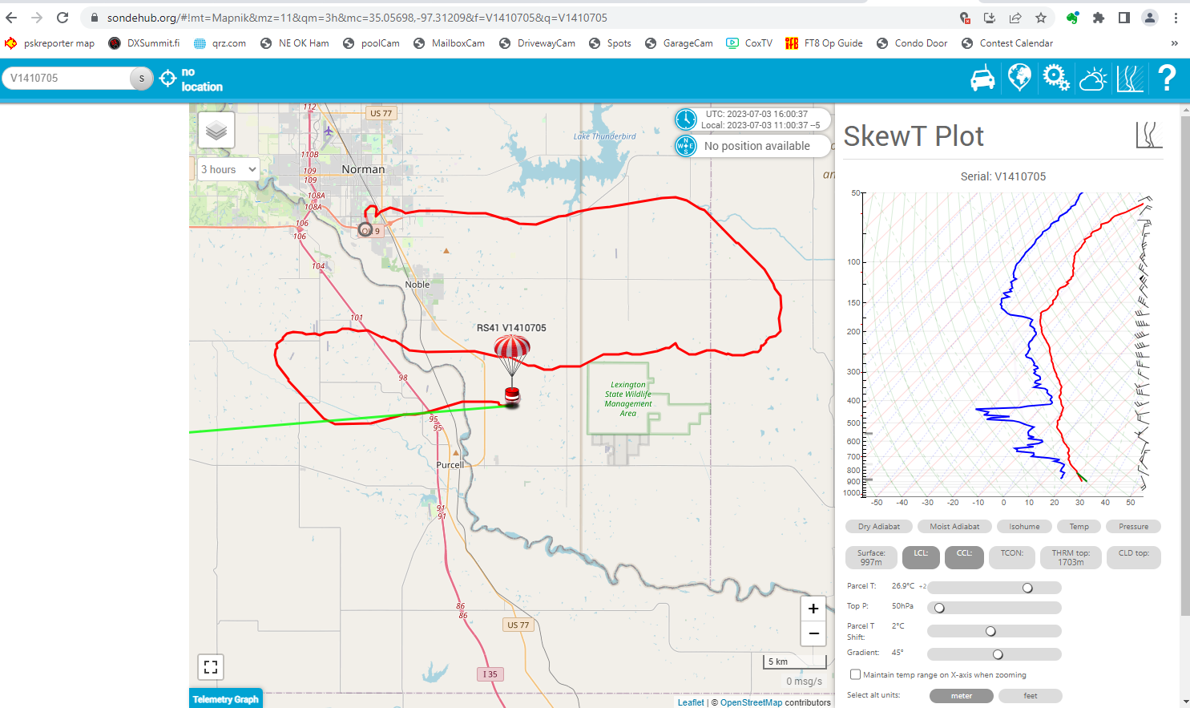
Example of local radiosonde track

Slide 17
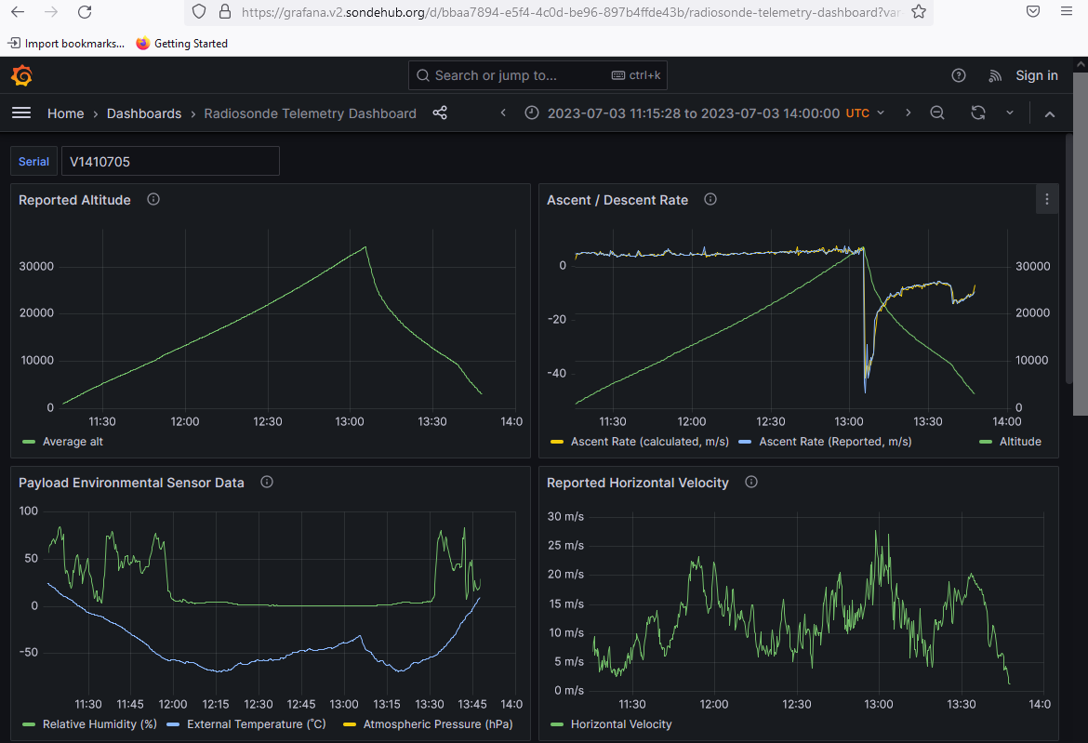
Example of Available Data

Slide 18
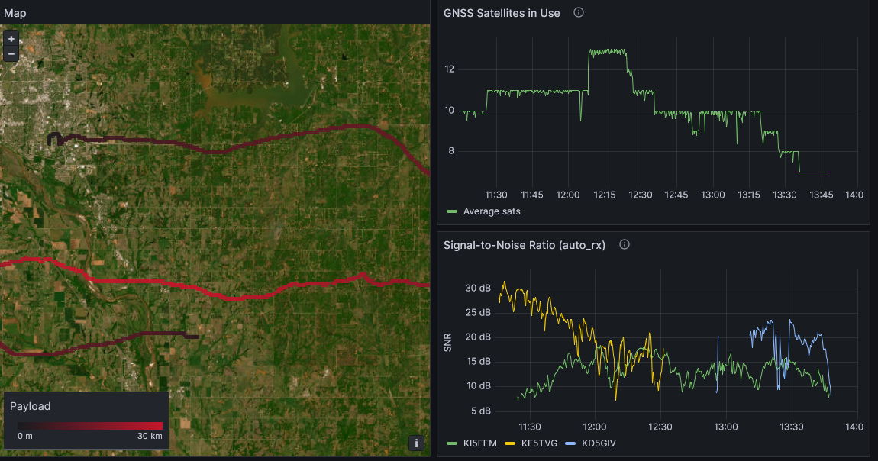
More Data Examples

Slide 19
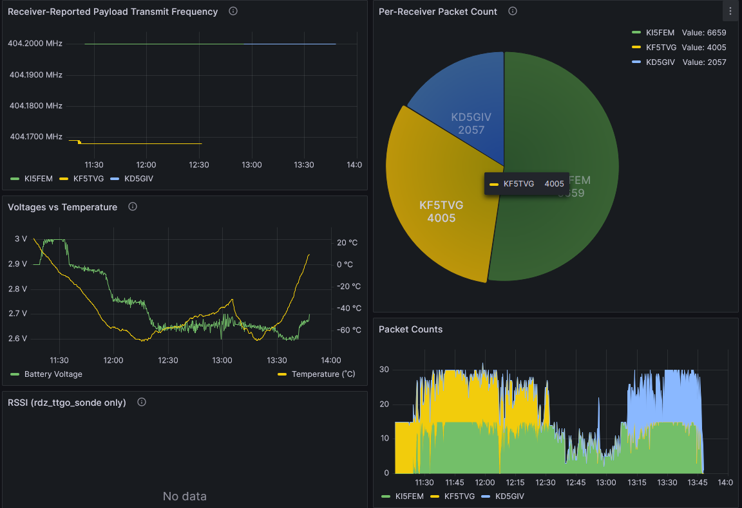
More Data Examples

Slide 20
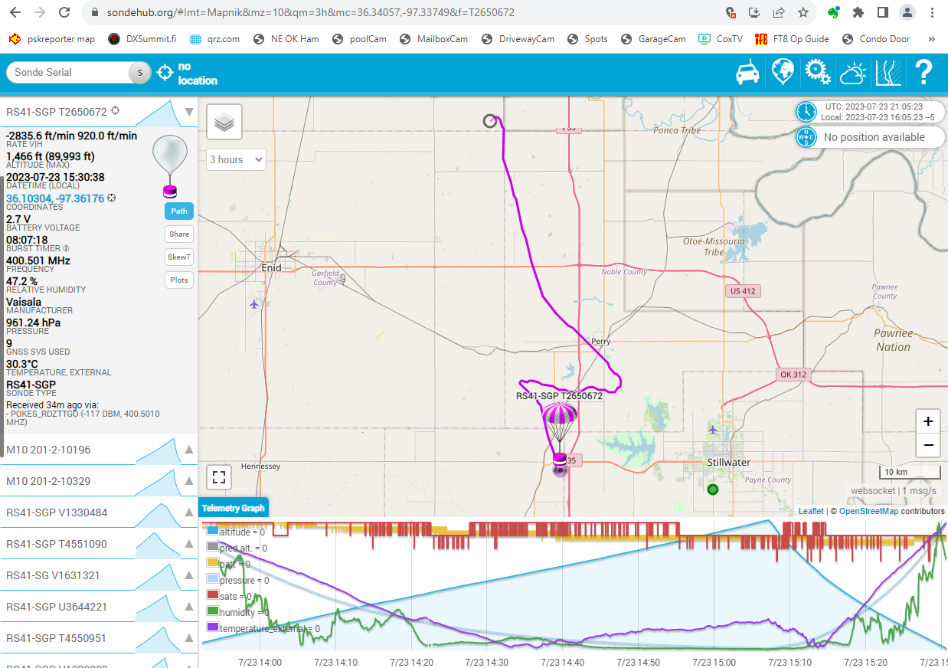
“Non-Routine” launch from Sulpher

Slide 21
What’s Needed to Track/Chase
We’ll focus on 2 options now
RaspberryPi (RPi) based system
LilyGo T-Beam STM32 development board

Slide 22
What’s Needed to Track/Chase (RPi)
RaspberryPi 3 or 4 (Mouser: $55-$75)
Rtl-sdr (v3 w/.5ppm tcxo) USB w/ sma connector (Amazon: $35)
GPS dongle w/USB (Amazon: GlobalSat BU-353-S4, $35)
HDMI monitor (probably already have, get 12v for mobile)
Typical ham antenna for 70cm (probably already have)
Adapter cable between sma and pl259
If mobile, add appropriate battery/converter

Slide 23
What’s Needed to Track/Chase (RPi)
For RPi Software
Load/configure github.com/projecthorus/radiosonde_auto_rx
Load/configure github.com/projecthorus/chasemapper
Start web browser
New tab for https://sondehub.org
New tab for http://localhost:5000 to see ‘sonde from sdr dongle
New tab for http://localhost:5001 for both ‘sonde and your gps

Slide 24
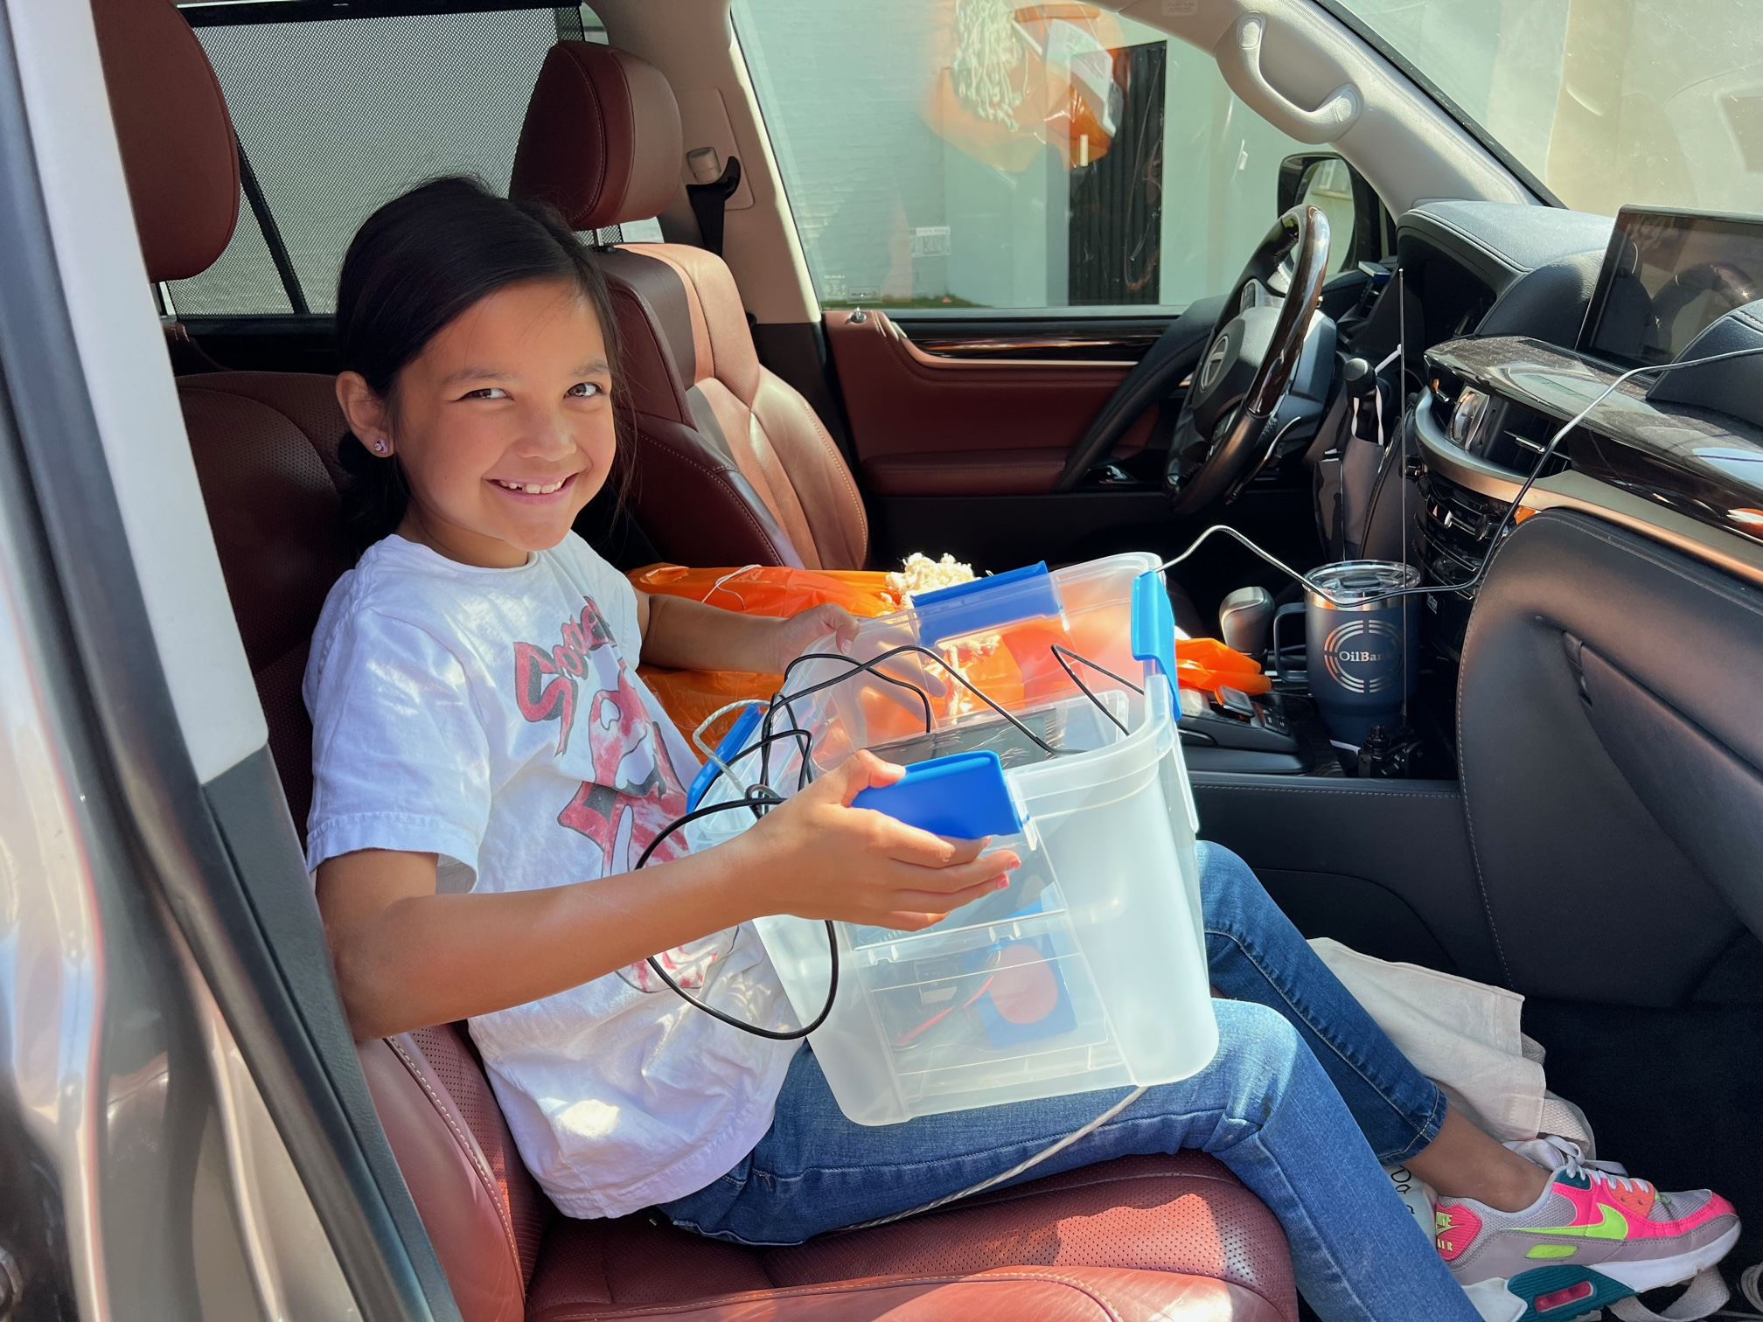

Retrieval with Rpi-Based Tracker

Slide 25
What’s needed to Track/Chase (T-Beam)
LilyGo T-Beam LoRa V1.1 ESP32 433MHz Dev Board, includes UHF receiver, WiFi, GPS, small display (Amazon $35)
18650 Lithium Battery or 5v phone recharger
Your phone/tablet/PC
Firmware from github.com/dl9rdz/rdz_ttgo_sonde
Install firmware into T-Beam
HT 70cm ham antenna

Slide 26
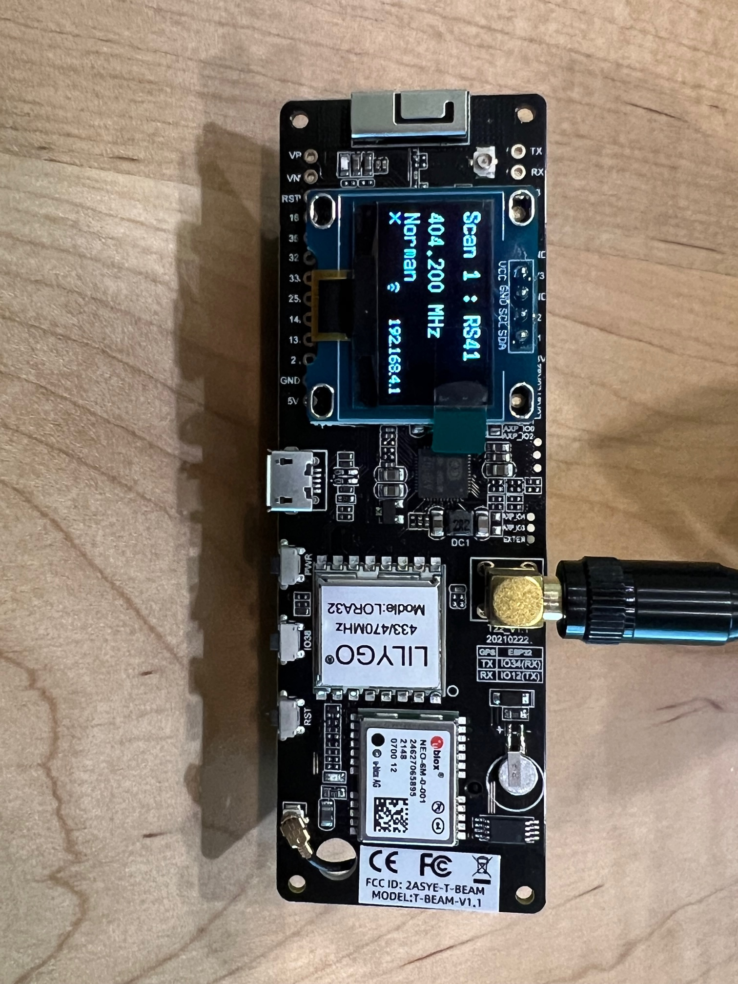
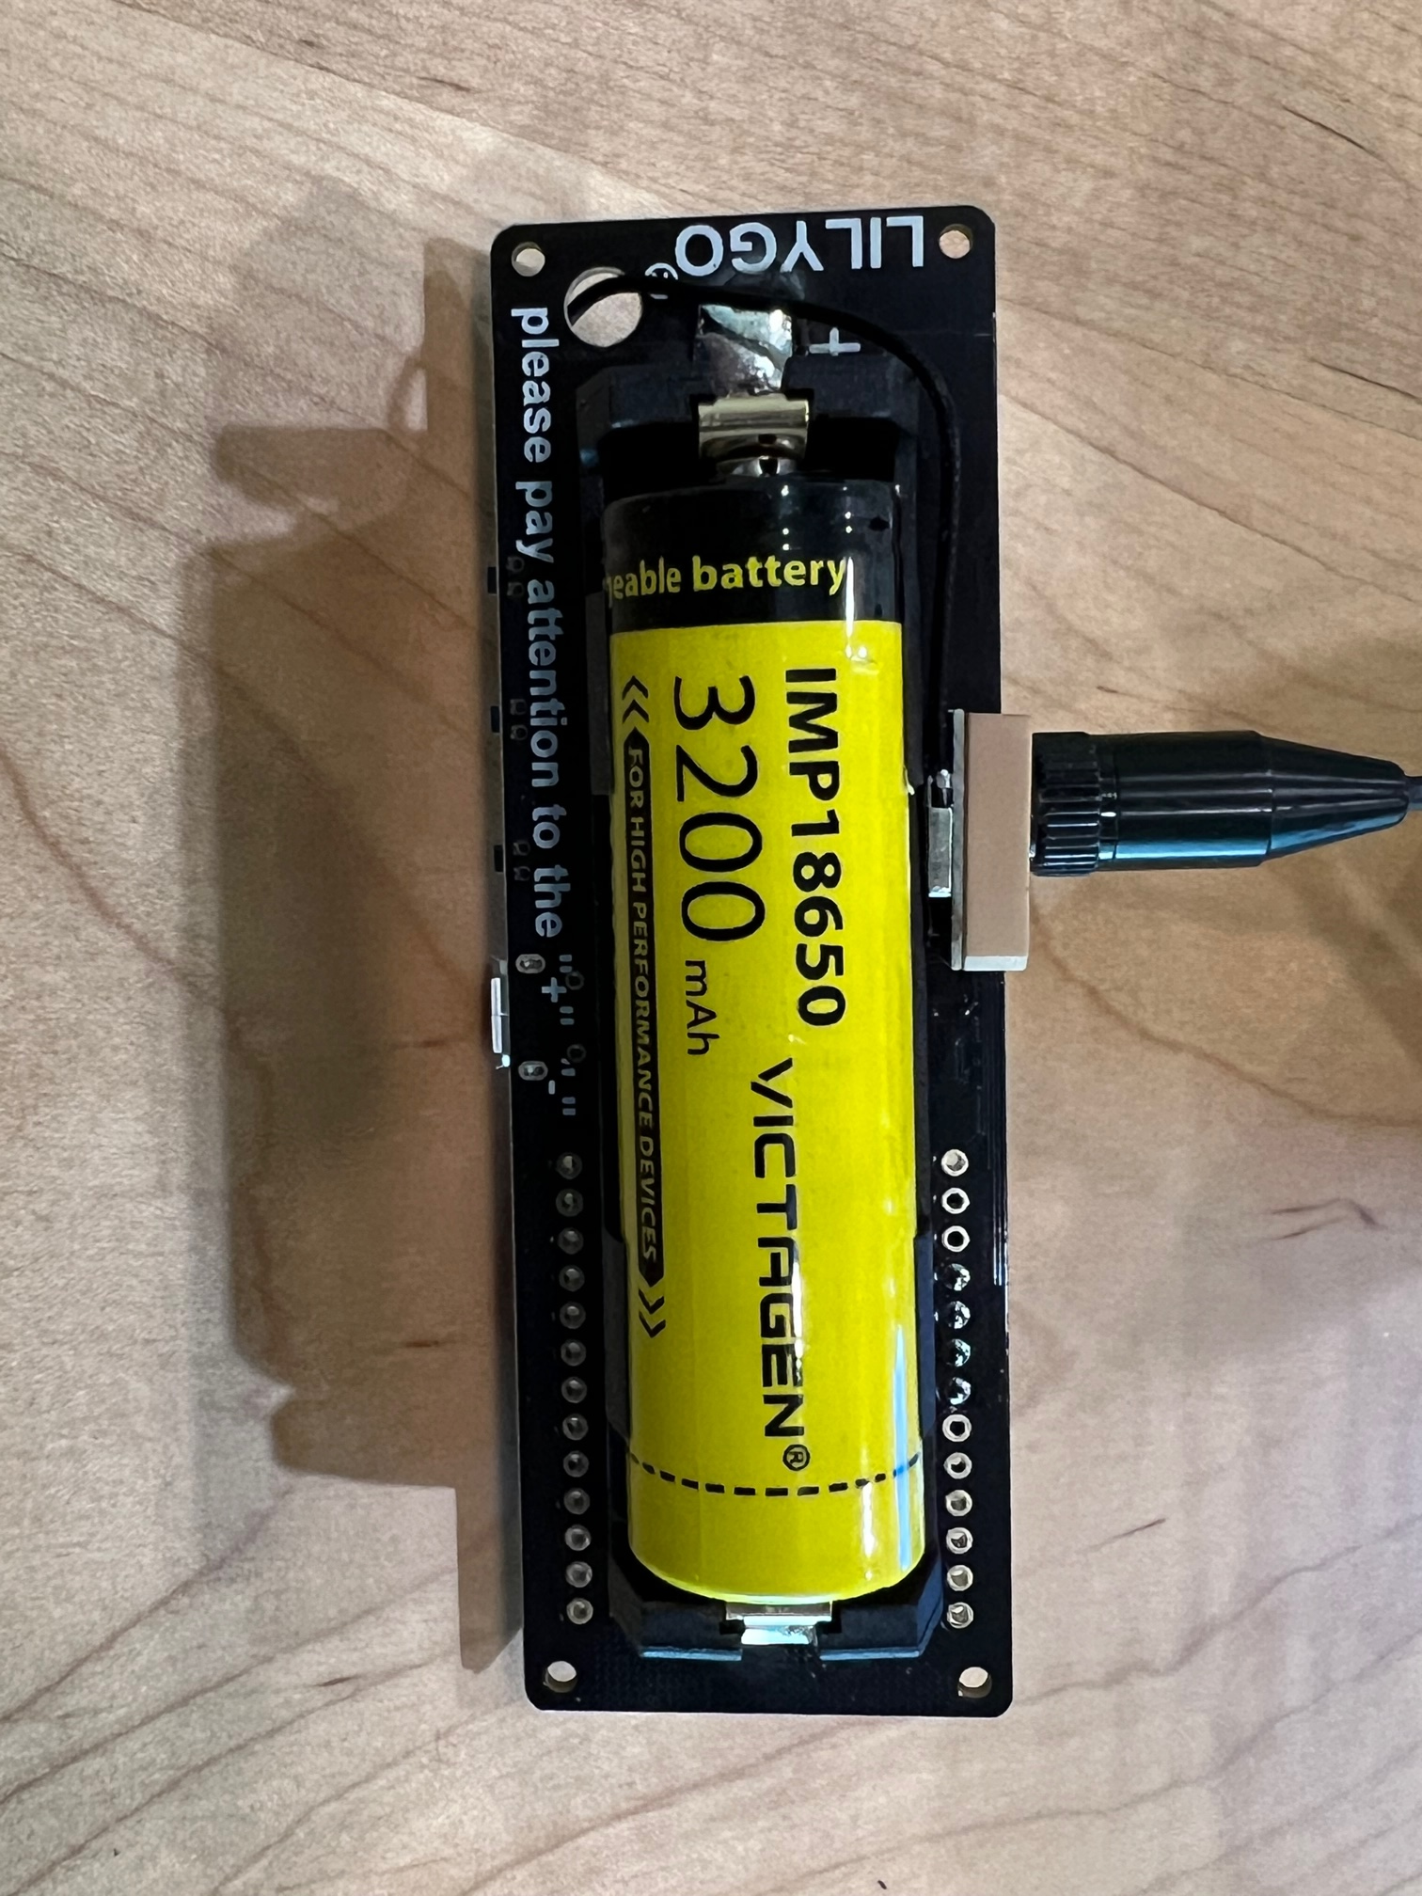
ESP32 T-Beam

Slide 27
Comparison: RPi and T-Beam
RPi based
Some linux knowledge useful
May have most of the pieces already
Scans for strongest signal
Maps on HDMI or phone
Good for Base or Mobile
T-Beam based
Easy to install firmware
Easy to use, Few pieces
Must predefine freqs
Use phone/tablet for maps
Send landing pt to phone or tablet and track there
Great for chasing

Slide 28
What’s Needed to Track (Other Options)
Windows 7 or 10 PC or Laptop
Install Application Called RS41Tracker
Install Zadig Windows driver for RTL-SDR
Use RTL-SDR and GPS Dongles described previously
Untested by me
Lilygo ESP32 LoRa Dev board w/o GPS (Amazon, $30)
Similar to full ESP32, but can’t track your location

Slide 29
What Can I Do with Recovered ‘Sonde?
1) Recycle with APRS protocol on Ham 70cm frequency
Reflash f/w to HAM UHF frequency
Need $15 ST-Link V2 interface (Amazon)
Add Bosch BME280 sensor for Temp/HumidityPressure
Add your callsign to config file
Attach to new balloon
Relaunch
Track with Ham radios that supports APRS (on UHF)

Slide 30
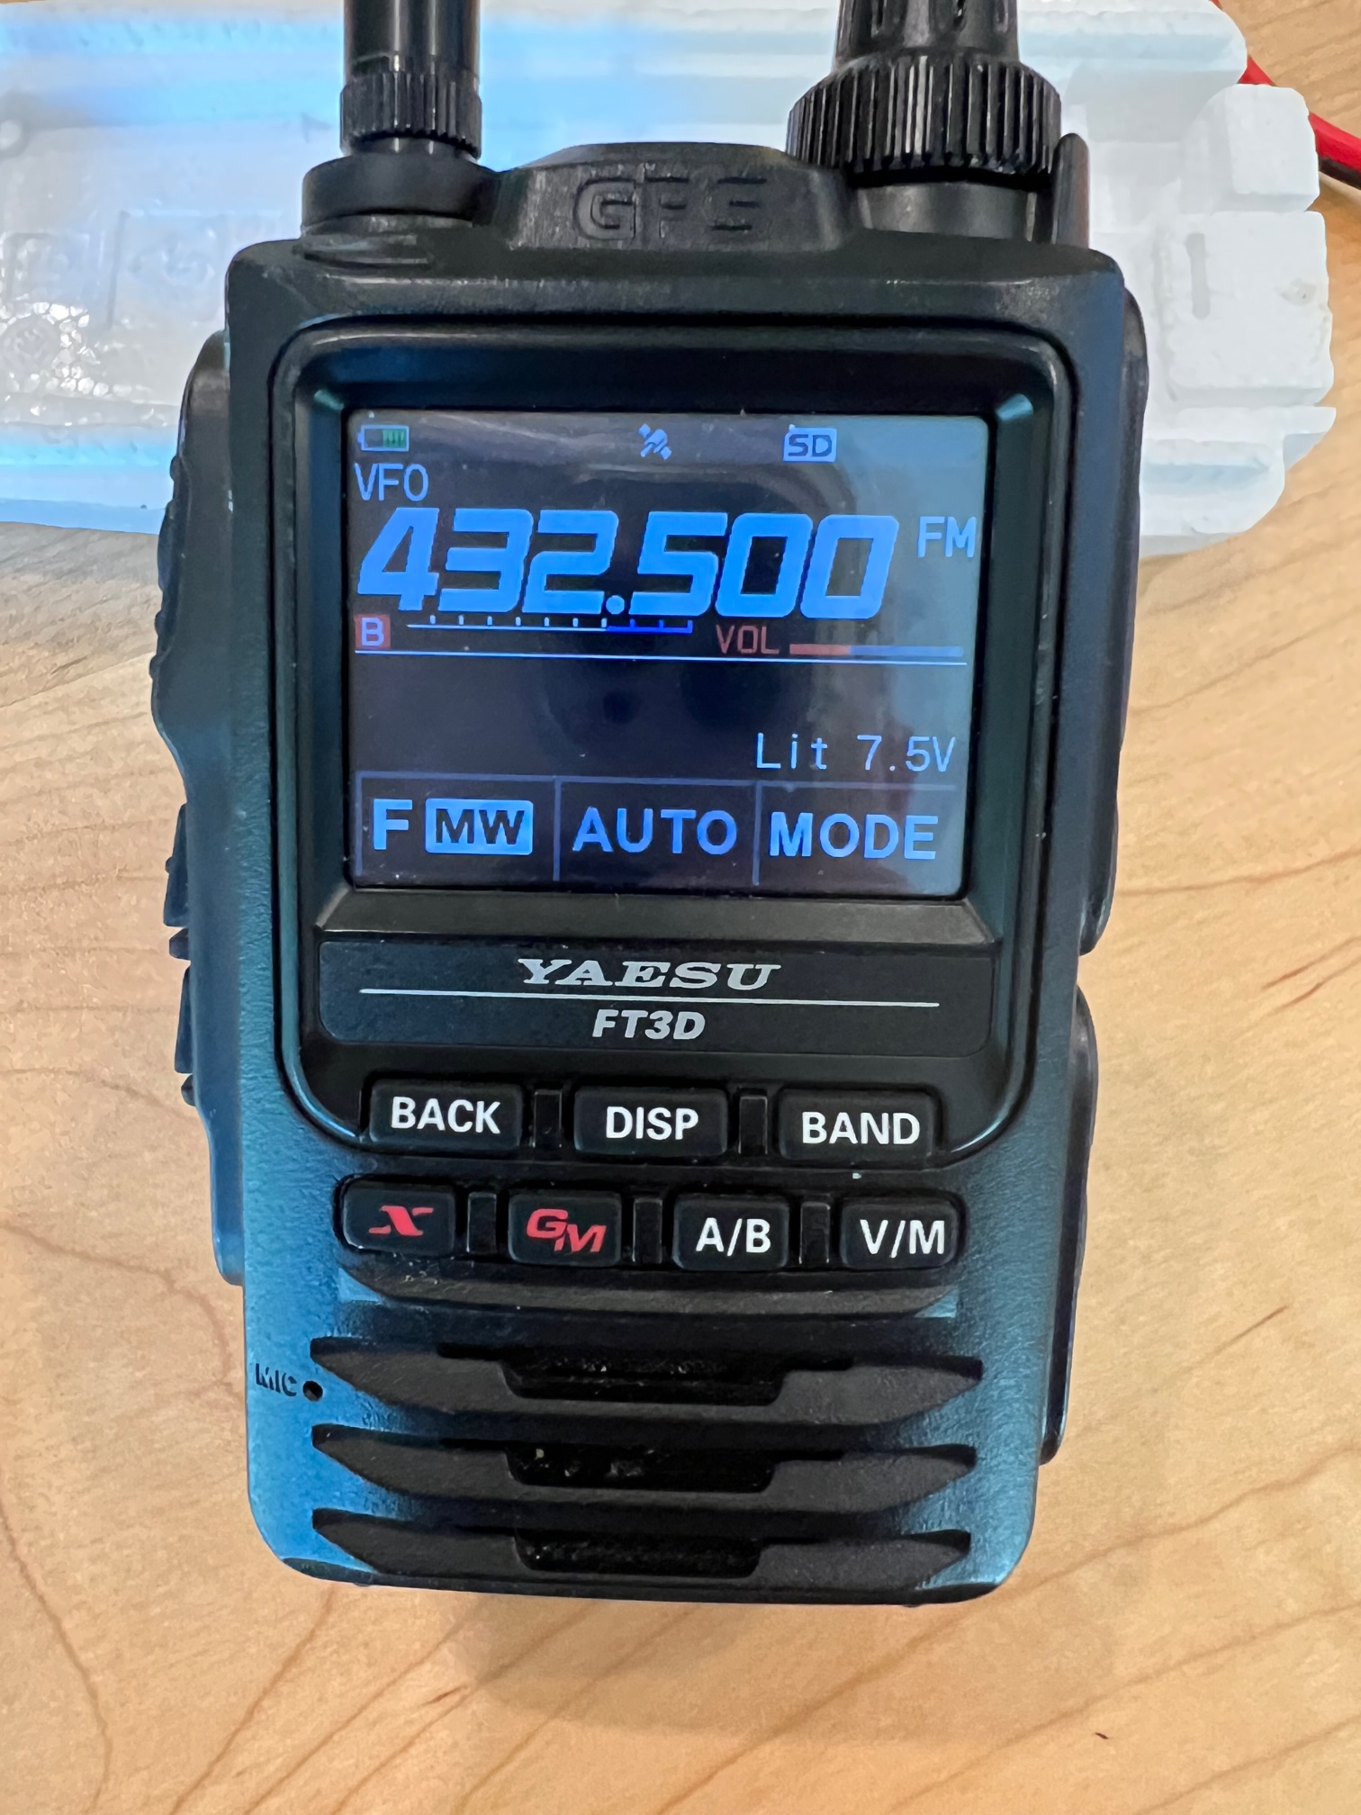
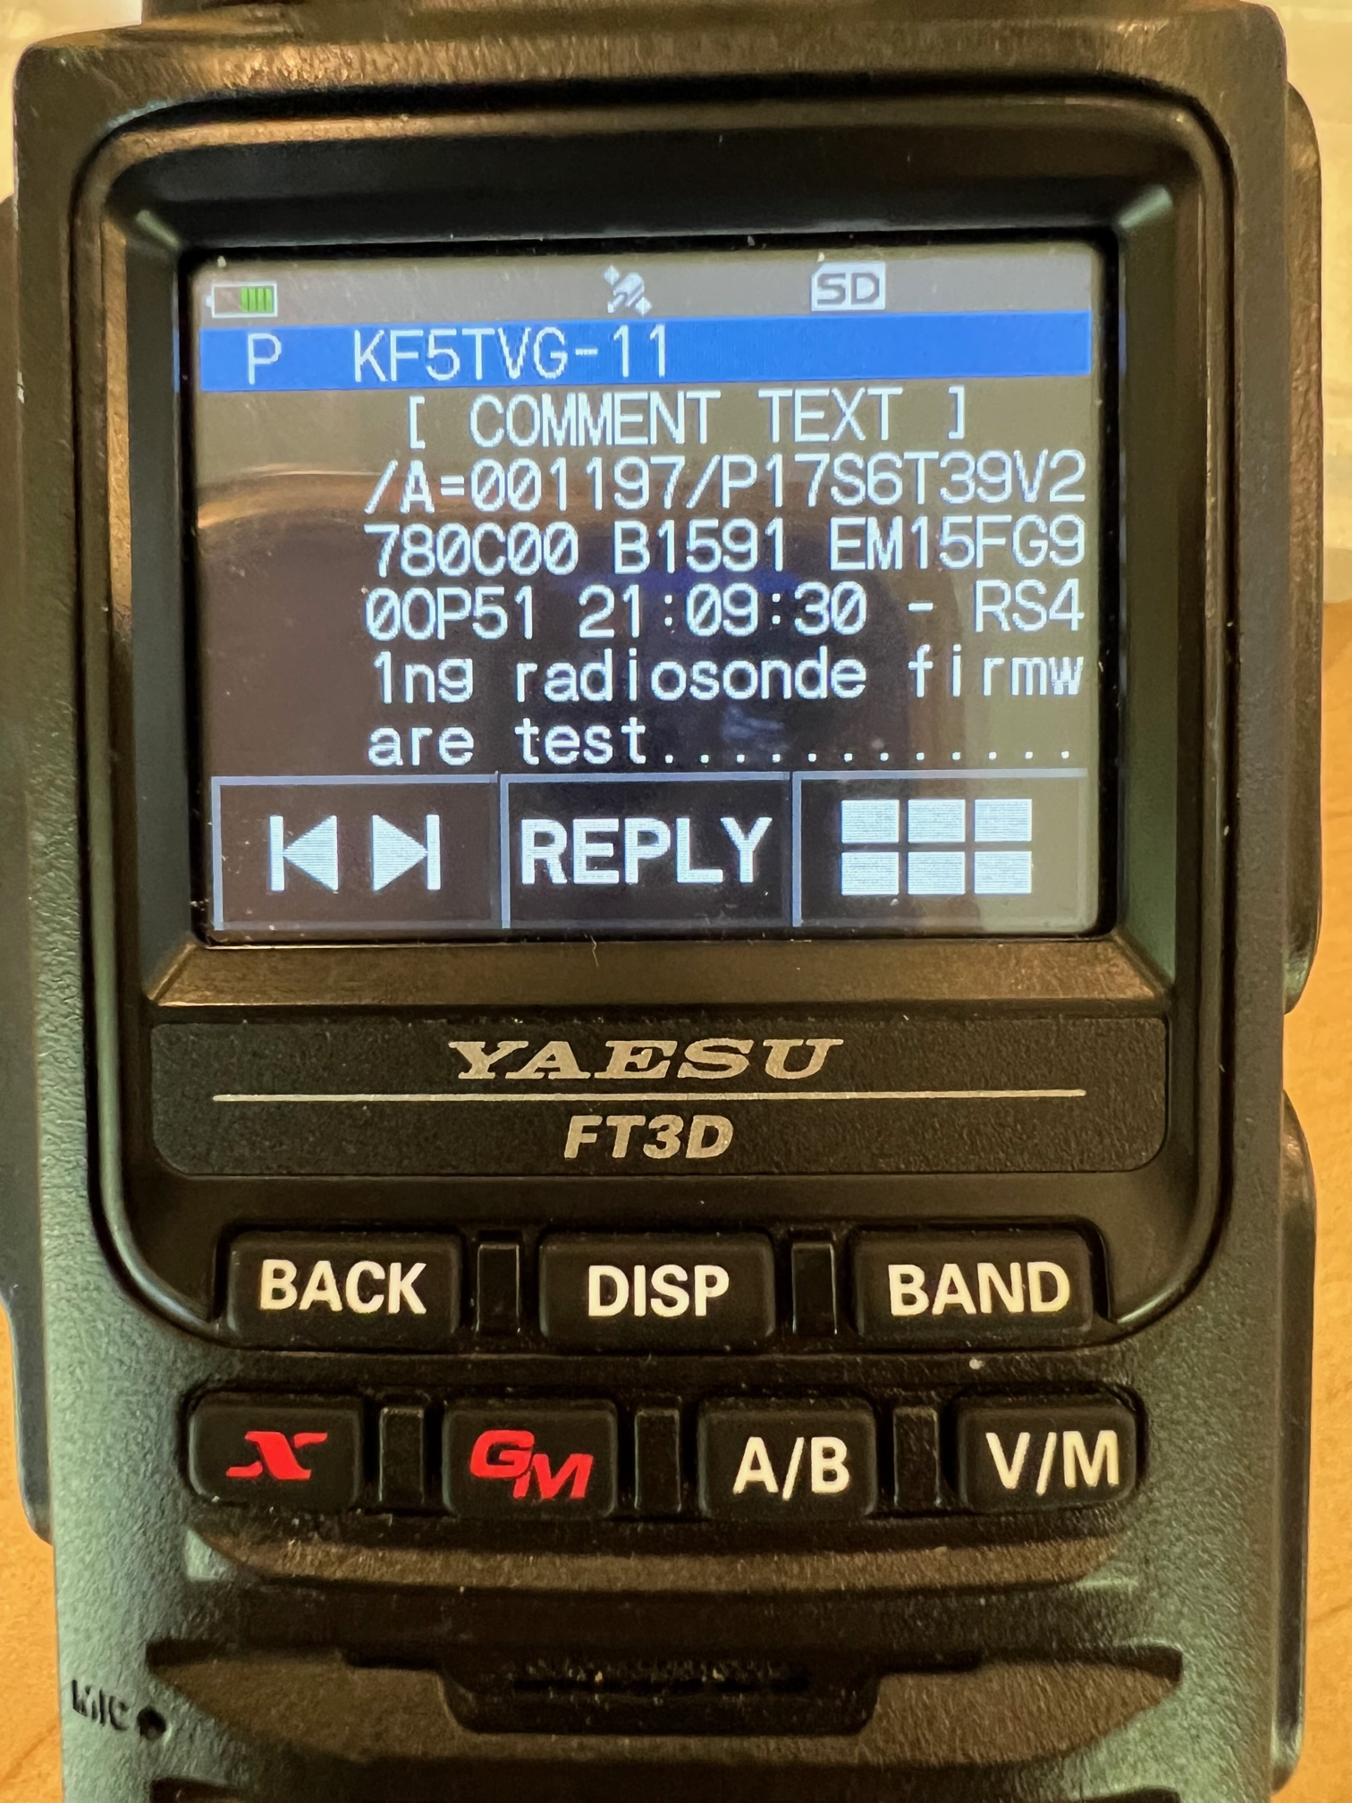
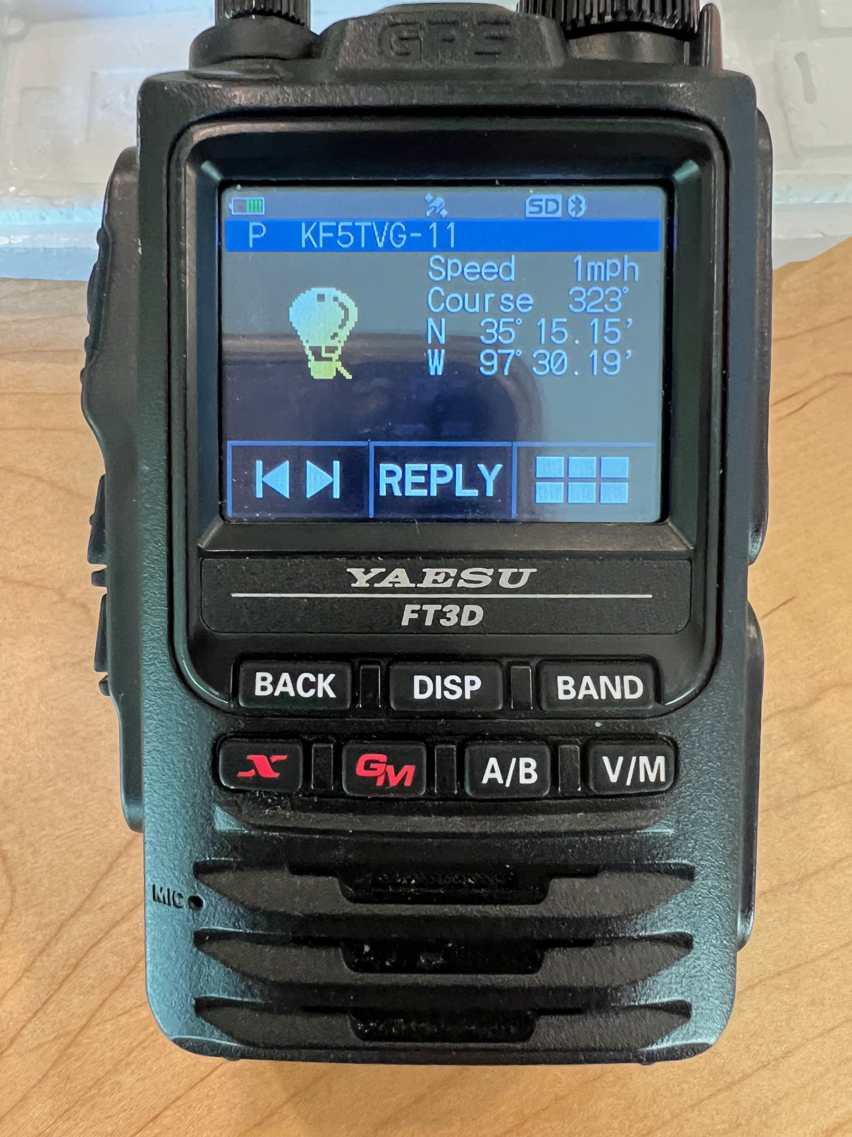
Reprogrammed for APRS on UHF

Slide 31
What Can I Do with Recovered ‘Sonde?
2) Recycle with Horus protocol on Ham 70cm frequency
Obtain registration from Horus group
Attach ESP32 to insert HAM UHF frequency on power up
Insert your callsign into firmware
Attach to new balloon
Relaunch
Track on http://amateur.sondehub.org

Slide 32
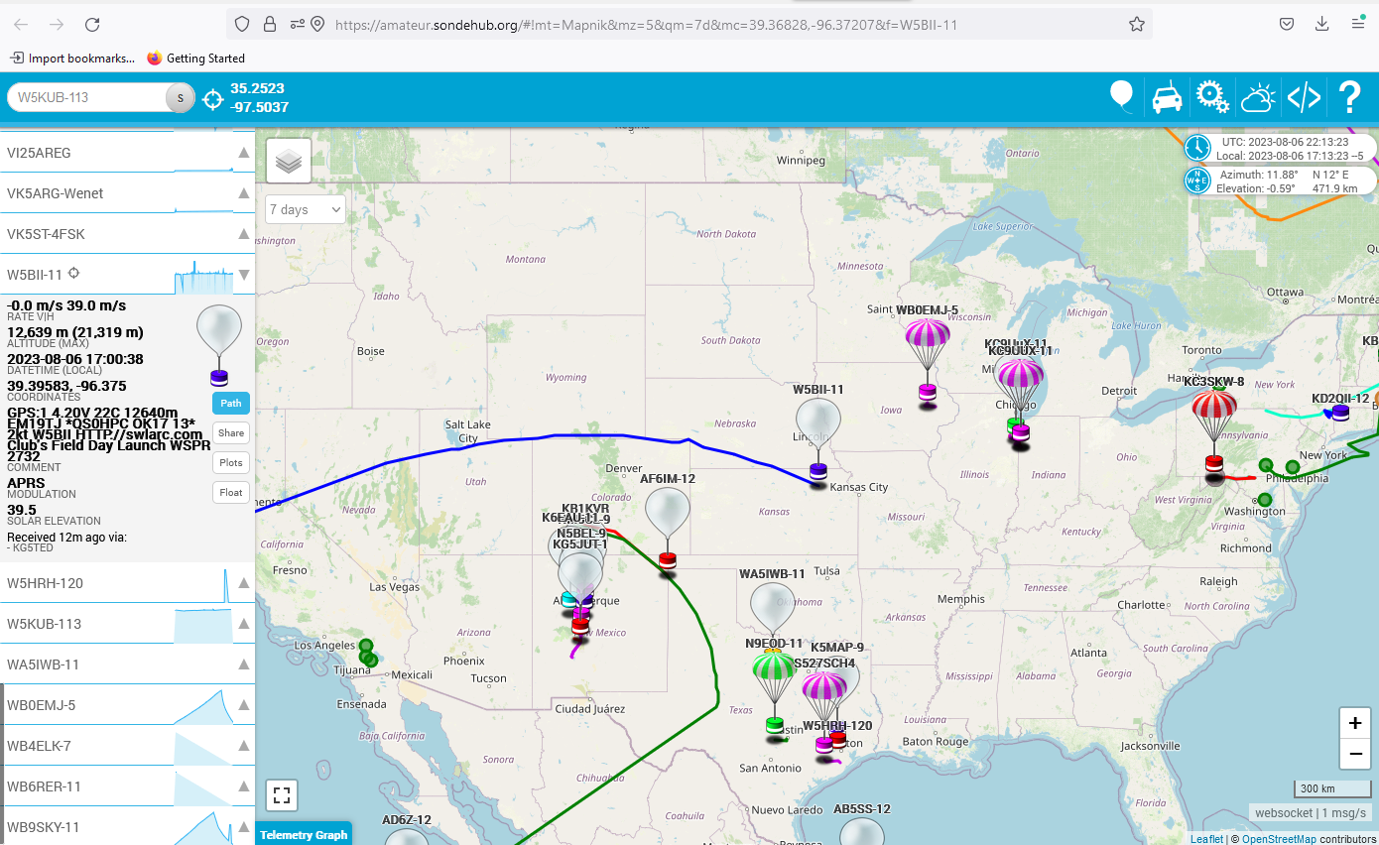
Amateur.sondehub.org (7 days)

Slide 33
What Can I Do with Recovered ‘Sonde?
3) Use as a hardwired GPS tracker
Attach to serial port of ‘sonde (9600 baud)
Sends out NMEA formated location data
4) Use as a mini Weather Station
Sends out temperature and humidity on serial port
5) Use as a Fox for Foxhunt
Program it to send out club callsign in CW

Slide 34
Live Demo by Rick
Live Demos
Correct Bob’s disinformation
Comments on ‘sonde recovery challenges

Slide 35
Next Steps?
How Do I get started?
Elmer Night is a good place for followup
How do we launch ‘sondes or other beacons?
Some balloon history already here in club?
See if enough interest to send balloons up?
Possibly install tracking station on OU campus?
Possibly team up with elementary/middle schools for STEM?
Do a foxhunt?

Slide 36
Possible Weather/Balloon/Radio Template
See HABGab 2023 project from New England SCI-TECH at http://nescitech.org
From a single 2000g weather balloon:
Crossband UHF/VHF repeater that lasted 2-3 hours
Auto-rotation copter released at 80k ft w/ lightAPRS tracker
Glider released at 80k ft w/ tracker, APRS on 144.390
Live 2 camera video feed at 1.2GHz
Main payload with repurposed RS41 ‘sonde on 432.501MHz

Slide 37
Primer on Radiosonde Chasing
Questions/Comments?

