Slide 1

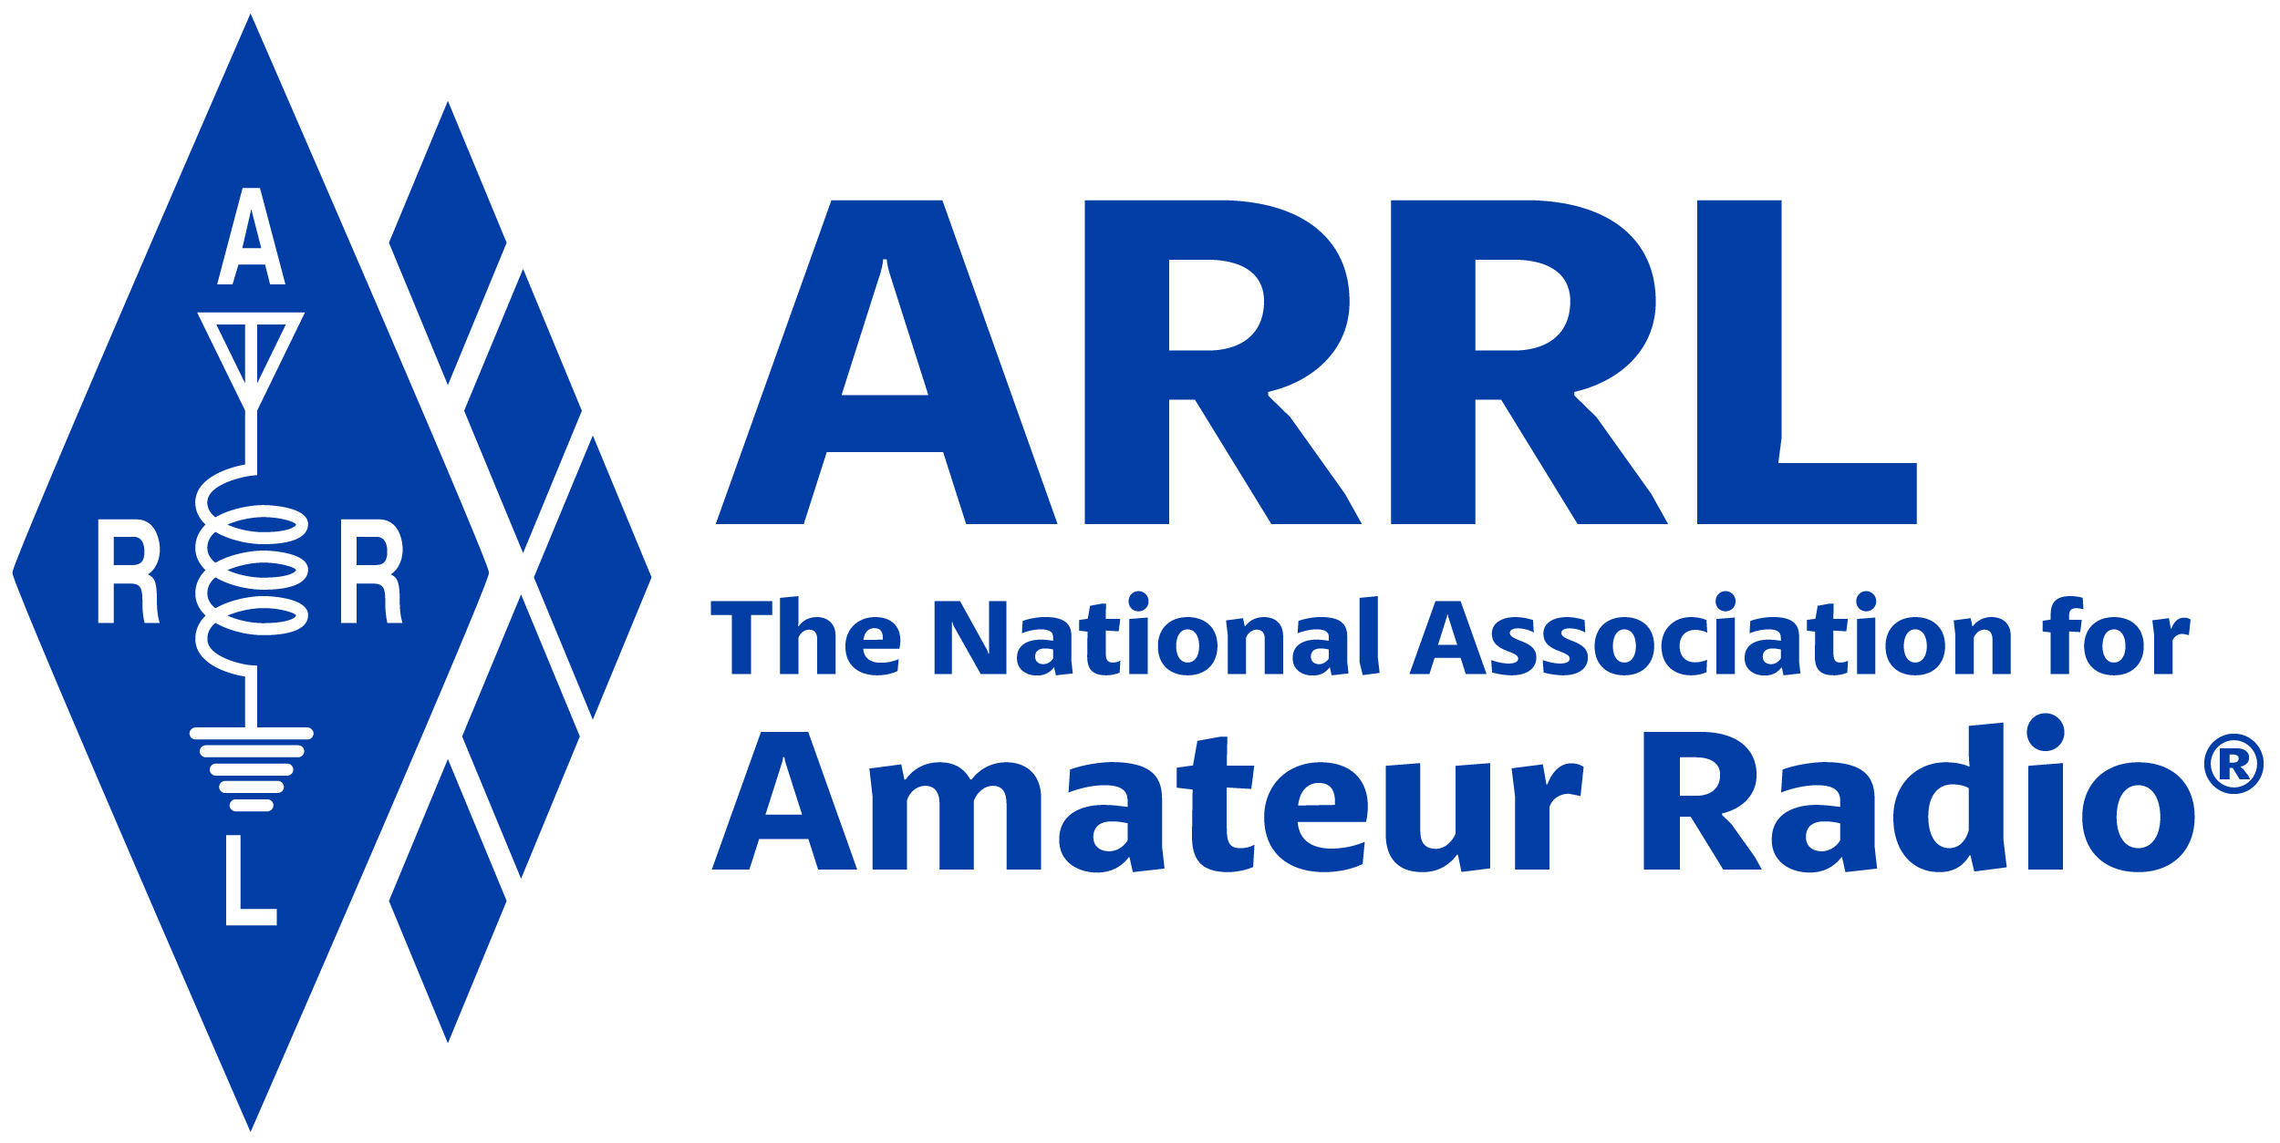
Amateur Radio Technician Exam Preparation Course

Slide 2
Amateur Radio Technician Exam Prep Course
Module 2
Radio and Signals Fundamentals
2.1 Radio Signals and Waves
2.2 Radio Equipment Basics

Slide 3
Metric Prefixes – The Language of Radio
(see Table 2.1)
Metric system used because numbers cover large range of values
Most common prefixes in radio …
  Pico (p), 0.000000000001, 10⁻¹²
  Nano (n), 0.000000001, 10⁻⁹
  Milli (m), 0.001, 10⁻³
  Centi (c), 0.01, 10⁻²
  Kilo (k), 1000, 10³
  Mega (M), 1000000, 10⁶
  Giga (G), 1000000000, 10⁹
NOTE: Mega and Giga use capital letters in the abbreviation.

Slide 4

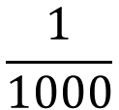




Table 2.1: International System of Units (SI) — Metric Units
PREFIX | SYMBOL | MULTIPLICATION FACTOR
Tera | T | 10¹² = 1,000,000,000,000
Giga | G | 10⁹ = 1,000,000,000
Mega | M | 10⁶ = 1,000,000
Kilo | k | 10³ = 1000
Hecto | h | 10² = 100
Deca | da | 10¹ = 10
Deci | d | 10⁻¹ = 0.1
Centi | c | 10⁻² = 0.01
Milli | m | 10⁻³ = 0.001
Micro | µ | 10⁻⁶ = 0.000001
Nano | n | 10⁻⁹ = 0.000000001
Pico | p | 10⁻¹² = 0.000000000001
NOTE
$$\frac{1}{10}$$
$${10}_{}^{−1}$$
=
$$\frac{1}{100}$$
$${10}_{}^{−2}$$
=
$$\frac{1}{1000}$$
$${10}_{}^{−3}$$
=

Slide 5
Frequency (See Fig 2.1)
Radio waves continually vary in strength or amplitude
This continual change is called oscillating
Each complete up-and-down sequence is called a cycle
Frequency (f) is the number of cycles/second (measured in Hertz, Hz)
The period of the cycle (T) is its duration
A harmonic is a signal with a frequency that is some multiple (×2, ×3, ×4 and so on) of a fundamental frequency

Slide 6
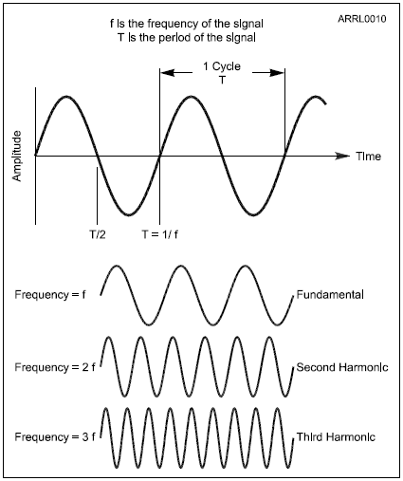
Figure 2.1: The frequency of a signal and its period are reciprocals. Higher frequency means shorter period and vice-versa.
WAVE VOCABULARY
Amplitude
Frequency (hertz, Hz, cycles/sec)
Period (T, seconds, s)
Fundamental
Harmonics

Slide 7
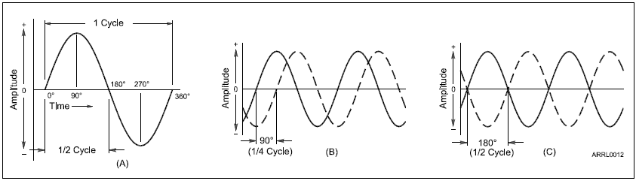
Figure 2.2: PHASE is used as a measure of time within the signal. Each cycle of a sine wave is divided into 360° of phase (A). Parts (B) and (C) show two special cases. In (B) the two signals are 90° out of phase, and in (C) they are 180° out of phase.
Position within a cycle is called phase. Phase is used to compare how sine wave signals are aligned in time. Measured in degrees.

Slide 8
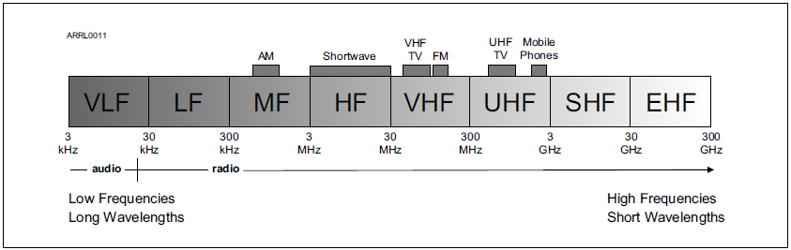
The Radio Spectrum
Signals that have a frequency greater than 20,000 Hz (or 20 kHz) are radio frequency or RF signals.

Slide 9
Electromagnetic Waves
Electromagnetic waves are made up of electric and magnetic energy (fields)
The electric and magnetic fields vary in the pattern of a sine wave
Electromagnetic waves travel at the speed of light
Moving electrons in an antenna take the place of the moving magnet
A signal from a transmitter can make the electrons in an antenna move, transferring energy from the signal to electromagnetic waves
The same process works backwards too
Electromagnetic waves encountering an antenna make its electrons move in sync with the wave

Slide 10
Electromagnetic Waves (cont.)
Electromagnetic energy is transferred from the wave to the electrons
The moving electrons create a signal that can be detected by a receiver
The electromagnetic spectrum is divided into ranges of frequencies in which electromagnetic waves behave similarly
Each range or segment has a different name
Waves with a certain range of frequencies which can be used for communication are called radio waves

Slide 11
The Radio Spectrum (cont.)
The range of radio signal frequencies is called the radio spectrum
Starts at 20 kHz and continues through several hundred GHz
A specific range of frequencies in which signals are used for a common purpose or have similar characteristics is called a band
Frequency bands used by amateurs are called amateur bands or ham bands
Frequencies above 1 GHz are generally considered to be microwaves

Slide 12
Table 2.2: RF Spectrum Ranges
Range Name | Abbreviation | Frequency Range
Very Low Frequency | VLF | 3 kHz – 30 kHz
Low Frequency | LF | 30 kHz – 300 kHz
Medium Frequency | MF | 300 kHz – 3 MHz
High Frequency | HF | 3 MHz – 30 MHz
Very High Frequency | VHF | 30 MHz – 300 MHz
Ultra High Frequency | UHF | 300 MHz – 3 GHz
Super High Frequency | SHF | 3 GHz – 30 GHz
Extremely High Frequency | EHF | 30 GHz – 300 GHz

Slide 13
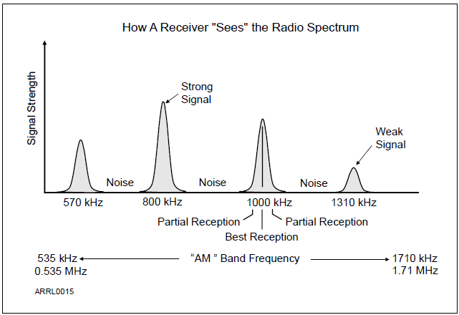
Figure 2.4
As a radio receiver is
tuned across the
AM broadcast band,
starting at the left, it encounters each signal in turn. Between signals, only noise is received. Although signals can be received slightly lower and higher in
frequency, the signal is received best when the receiver is tuned exactly to the signal’s frequency.

Slide 14
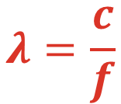

Wavelength
Wavelength is the distance a radio wave travels during one cycle of the wave’s electric and magnetic fields
λ (lambda) is the symbol for wavelength
Waves travel at the speed of light, c (300,000,000 or 3 × 10⁸ meters per second)
Hams can refer to bands by frequency (50MHz) or wavelength (6 meters)
Because radio waves travel at a constant speed (one wavelength) …
$$λ=\frac{c}{f}$$

Slide 15
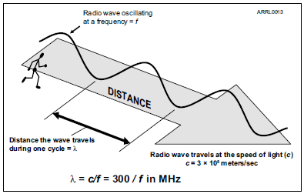
Wavelength (cont.)
Figure 2.5 — As a radio wave travels, it oscillates at the frequency of the signal. Wavelength is the distance traveled by the wave during
the time for one complete cycle.
A radio wave can be referred to by wavelength or frequency because the wave is moving
at a constant velocity — the speed of light. If you know the frequency of a radio wave, you automatically know its wavelength!

Slide 16
Radio Equipment Basics
Antenna
The Basic Radio Station
(also called a Transceiver)
Feed line
Transceiver
TRANSMITTER
TR SWITCH
RECEIVER
POWER SUPPLY

Slide 17
An Amateur Radio Station Consists of 3 Basic Elements
Transmitter (XMTR)
  Generates a signal carrying speech, Morse Code, or data
Receiver (RCVR)
  Recovers the signal from someone else’s transmitter
Antenna
  Turns signals from transmitter into energy (radio waves)
  Captures signals (radio waves) and turns them into signals for the receiver
  A feed line (or transmission line) connects the antenna to the transmitter or receiver
Most systems combine transmitter & receiver into a Transceiver (abbreviated XCVR)

Slide 18
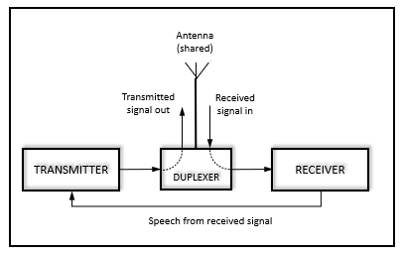
Radio Equipment Basics (cont.)
Repeaters

Slide 19
Repeaters
Consists of a receiver and transmitter that re-transmit info from a received signal simultaneously on another frequency or channel
  Called duplex communication
Usually located on high buildings, towers, hills, etc. for max. range
Provide local & regional communications between low-power stations
Often used for local emergency “traffic”
Can be used for voice, data, or video signals (voice is the most common)
The duplexer allows the repeater’s transmitter and receiver to share a common antenna at the same time

Slide 20

END OF MODULE 2

