Slide 1

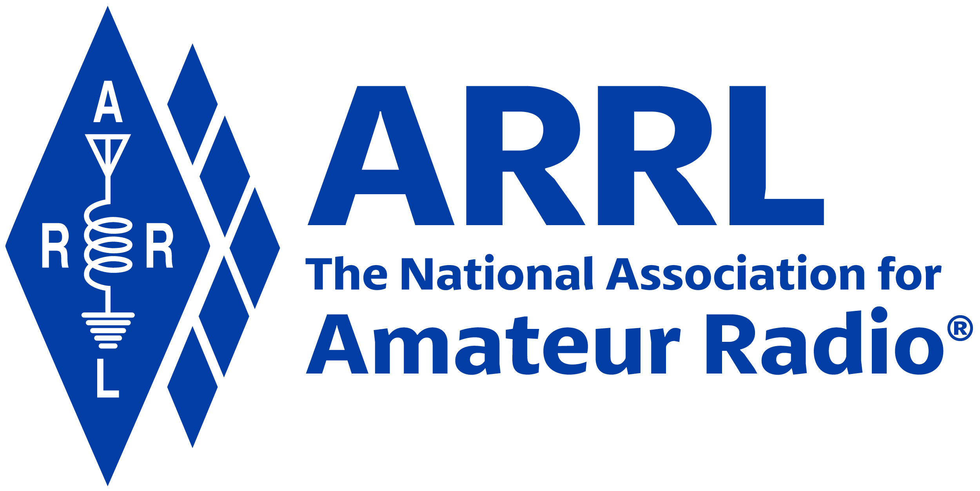
Amateur Radio Technician Exam Preparation Course

Slide 2
Amateur Radio Technician Exam Prep Course
Module 5
Amateur Radio Equipment
5.1 Modulation
5.2 Transmitters and Receivers
5.3 Digital Communications
5.4 Power Supplies and Batteries

Slide 3
Modulation & Bandwidth
Antenna
The Basic Radio Station
Feed line
Transceiver
TRANSMITTER
TR SWITCH
RECEIVER
POWER SUPPLY
Review from previous module

Slide 4
Adding Information – Modulation
When we add some information to the radio wave, (the carrier) we modulate the wave
  Turn the wave on and off (Morse code)
  Speech or music
  Data
Different modulation techniques vary different properties of the wave to add the information:
  Amplitude, frequency, or phase
A signal that doesn’t carry any information is called unmodulated
Recovering the information from a modulated signal is called demodulation

Slide 5
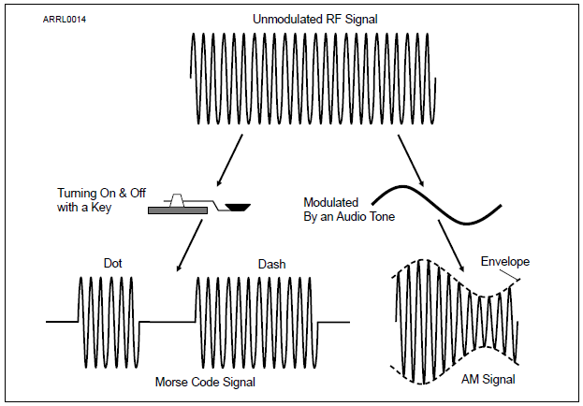
Continuous Wave (CW)
The simplest type of modulation is a continuous wave turned ON and OFF in a coded pattern
Morse code radio signals are called CW for that reason
Figure 5.1 — Information can be added to an RF signal by modulating the signal’s amplitude.

Slide 6
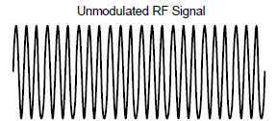
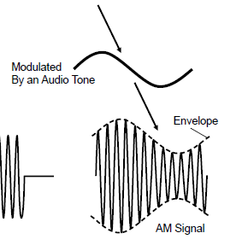
Amplitude Modulation (AM)
In AM, the amplitude of the carrier wave is modified in step with the waveform of the information (the tone shown here)
The information is contained in the outline or envelope of the resulting signal
Recovering speech or music from the envelope of an AM signal is called detection

Slide 7
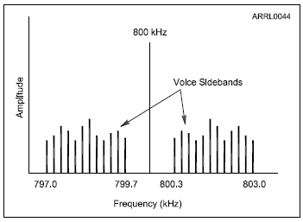
Composite Signals – Sidebands
An actual AM signal is made up of three separate signals working together — a carrier and two sidebands
The carrier is a steady, unmodulated signal
The upper sideband or USB signal is higher in frequency than the carrier
The lower sideband or LSB signal is lower in frequency than the carrier

Slide 8
SINGLE-SIDEBAND (SSB)
In an AM signal the carrier doesn’t carry any information
Each sideband contains a copy of the modulating signal
Only one sideband is needed to transmit the information
All of the SSB signal’s power is concentrated in the one sideband
  SSB signals are effective for long-distance and weak signal voice contacts because of the additional power
The upper sideband (USB) is used on VHF and UHF
Both USB and LSB are used on the MF and HF bands

Slide 9
Frequency and Phase Modulation
Modes that vary the frequency of a signal to add speech or data information are called frequency modulation or FM
The frequency of an FM signal varies with the amplitude of the modulating signal
Phase modulation varies a signal’s phase instead of changing its frequency … in other words, very similar to FM
FM is the mode used by most VHF and UHF repeaters
Because of the way FM receivers work, only one signal can be received at a time. This is called the capture effect and if multiple signals are present, only the strongest will be heard in the receiver.

Slide 10
Bandwidth of Modulated Signals
A signal can have both a frequency and a strength or amplitude
Signals are spread out over a range of frequencies (called bandwidth)
You can communicate with SSB over much longer ranges and in poorer conditions than with FM or AM, particularly on the VHF and UHF bands
For even better range, extremely narrow CW signals are the easiest for a human operator to send and receive, particularly in noisy or fading conditions
CW and SSB are considered weak signal modes because they are more effective than FM at low signal strengths

Slide 11
Bandwidth of Modulated Signals (cont.)
If an SSB signal can use either an upper or lower sideband — which one should you use?
Ham radio has standardized on the following conventions …
  Below 10 MHz, LSB
  Above 10 MHz, USB — including all of the VHF and UHF bands
    One exception: amateurs are required to use USB on the five channels of the 60 meter band (5 MHz)

Slide 12
Transmitters and Receivers
Usually combined into one unit called a transceiver
Give you control of frequency and mode
Generalized categories
  Mobile
  Single band
  Dual band
  All band
  Multi-mode
  Handheld or HT

Slide 13
Single-Band Mobile
Single-band, 2 meter … good starter radio
Operates from 13.8 volts DC, requires external power supply or car battery
Requires an external antenna
Can be operated mobile or as a base station
Limited to frequency modulation (FM) and usually either 2 meters or 70 cm bands
Up to approximately 50 watts output
Typical frequencies: VHF/UHF FM

Slide 14
Dual-Band Mobile
Same as the single-band transceiver but includes additional band(s)
Most common are 2 meter and 70 cm bands
Often includes 6 meters, 222 MHz (1.25 meters) or 1.2 GHz bands
Might have separate antenna connections for each band or a single connection for a dual-band antenna
Up to approximately 50 watts output
Typical frequencies: VHF/UHF FM

Slide 15
Multimode Transceiver
Nearly all HF rigs are multimode
VHF multimode operates on FM plus AM/SSB/CW modes
Required for weak-signal operation on VHF/UHF
More features add complexity and cost
More flexibility will allow you to explore new modes as you gain experience (and increased license privileges)

Slide 16
Multiband Transceiver
Covers many bands – usually refers to coverage of HF + VHF/UHF
Also covers all modes
Frequently 100 watts on HF, some power limitations on high bands (25-50 watts)
Larger units have internal power supplies, smaller units need external power supply
Some have built-in “tuners”

Slide 17
Handheld (HT) Transceiver
Small handheld FM units
Can be single band or dual band
Limited power (usually 5 watts or less)
Includes power (battery) and antenna in one package
Often purchased as a starter rig but low power limits range
Single, dual and multiband versions (with increasing cost and complexity)
Some can receive outside the ham bands, such as aircraft, commercial FM broadcast, etc.

Slide 18
Handheld (HT) Transceiver (cont.)
Very portable and self-contained
Internal microphone and speaker
Rubber duck antenna
Battery powered
Extra battery packs
  AA cell pack useful in emergencies
Drop-in, fast charger
Extended antenna
External microphone and speaker
Headset

Slide 19
Side-By-Side Comparison
 | SINGLE BAND | DUAL BAND | MULTIMODE | MULTIBAND | HANDHELD
FREQUENCY AGILITY | LIMITED | MEDIUM | MEDIUM | FULL | LIMITED
FUNCTION-ALITY | LIMITED | LIMITED | FULL | FULL | LIMITED
EASE OF USE | EASY | MEDIUM | MEDIUM | DIFFICULT | EASY
PROGRAM-MING | EASY | EASY | MEDIUM | CHALLENGING | EASY/MEDIUM
POWER | LOW | LOW | MEDIUM | HIGH | LOW
COST | LOW | MODEST | HIGH | HIGH | LOW

Slide 20
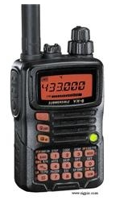
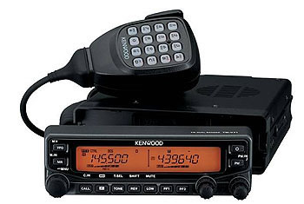
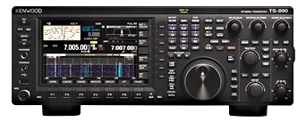
Sample Radios
HANDHELD (HT)
MULTIBAND
DUAL BAND

Slide 21
Selecting Band, Frequency and Mode
Two functions common to all radios …
  Control of frequency and mode
  Amateurs can use many different modes … most other radio services are restricted to a single mode
For multiband radios, begin by selecting the band
Then, select a frequency within the band (called tuning)
  Uses the variable frequency oscillator (VFO) and/or keypad (directly enter frequencies)
  Memories or memory channels are used to store frequencies and modes for later recall (quickly tune to frequently used frequencies)
For multimode radios, select the mode
  SSB, AM, FM, CW, Data

Slide 22
Transmitter Functions
Transmitter output power
  In HF rigs and radios using AM/SSB and CW, controlled by an RF power control knob
  FM handheld and mobile radios have selectable fixed power levels
Microphone gain controls the level of speech audio of SSB transmitters
  FM transmitters usually have a fixed microphone gain
Switching between receive and transmit on voice …
  Manual: Use push-to-talk (PTT) button
  Automatic: Voice-operated transmitter control circuit (VOX)
  On CW (Morse Code), use a key (an electronic keyer is faster than manual)
Use a dummy load to avoid interfering with other stations while you’re adjusting transmitter (heavy duty resistor that can absorb and dissipate output power)

Slide 23
Spurious Signals
Excessive modulation results in distortion of transmitted speech (spurious outputs on adjacent frequencies) … called splatter
Overmodulated FM signal has excessive deviation (overdeviating)
  Usually caused by speaking too loudly into the microphone
Overmodulation of an AM or SSB signal is caused by speaking too loudly or by setting the microphone gain or speech compression too high

Slide 24
Receiver Functions
AF Gain: Volume control (sets speaker or headphone listening level)
RF Gain: Adjusts the sensitivity of the receiver to incoming signals
Automatic Gain Control (AGC): Adjusts sensitivity to keep the output volume constant for both weak and strong signals
Squelch: Mutes the receiver’s audio output when no signal is present (eliminates continuous noise)
  Many transceivers have a monitor switch that temporarily opens the squelch to hear weak signals

Slide 25
Selectivity and Sensitivity
Receivers are compared on the basis of two primary characteristics: sensitivity and selectivity
Sensitivity determines receiver’s ability to detect signals
  Specified as a minimum detectable signal level (in µV)
A preamplifier (preamp) is used to boost sensitivity
Selectivity is the ability of a receiver to discriminate between signals
High selectivity means that a receiver can operate properly even in the presence of strong signals on nearby frequencies

Slide 26
Filtering and Tuning
A receiver rejects unwanted signals through the use of filters
Signals then pass through filters narrow enough (i.e., smaller bandwidth) to reject all but the desired signal
Wide filters (around 2.4 kHz) are used for SSB reception
Narrow filters (around 500 Hz) are used for CW and data mode
Multiple filters allows you to reduce noise or interference by selecting a filter with just enough bandwidth to pass the desired signal
Receiver incremental tuning (RIT … also called clarifier) is a fine-tuning control used for SSB or CW
  Allows you to tune in a station that is slightly off frequency or to adjust the pitch of an operator’s voice that seems too high or low

Slide 27
VHF/UHF RF Power Amplifiers
RF power amplifiers can be used to increase the output power by a factor of five or more
Many VHF/UHF power amplifiers can be used on all modes (including SSB and CW … switch between modes)
  Caution 1: Be sure your antenna is capable of handling the higher power!
  Caution 2: Be sure you learn about RF exposure!

Slide 28
Transverters
By using mixers, it is possible to convert an entire transceiver to operate on a different band
  Mixers are part of equipment called a transverter
A receiving converter mixer shifts input signals to the desired band where they are received as regular signals by the transceiver
Transverters allow one main transceiver to be used on one or more new bands

Slide 29
Digital Communications
Why use digital modes?
Special codes and characters embedded in the stream of data allow the receiving modem to detect [and correct] errors
Amateurs have developed or adapted techniques for exchanging digital data by transforming the 1s and 0s of data into tones that are in the same frequency range as the human voice

Slide 30
Amateur Digital Modes
Different combinations of protocols, codes, and modulation, such as SSB or FM, are used to create digital modes
Popular HF digital modes
  RTTY (radioteletype)
  PSK31 (keyboard-to-keyboard)
  FT8 and WSPR (weak signal modes)
  PACTOR or WINMOR (for Winlink messaging)
Popular VHF/UHF digital modes
  Packet radio
  B2F protocol (for Winlink)
  JT65 for moon-bounce and MSK144 for scatter paths
  IEEE 802.11 (Wi-Fi) adapted to amateur use on microwave bands
Popular Voice digital modes
  AOR and FreeDV (HF)
  D-STAR, System Fusion (C4FM), DMR, and P25 (VHF/UHF)

Slide 31
Packet and Packet Networks
On VHF and UHF, the most common digital mode is packet radio
Data characters are transmitted in groups called packets
Frequency-shift keying (FSK) is used to transmit individual characters
Each packet consists of a header, data, and checksum
If an error is detected, the receiver automatically requests the packet be retransmitted until the data is received properly (ARQ or automatic repeat request)

Slide 32
Keyboard-to-Keyboard Modes
Digital modes that are designed for real-time person-to-person communication are called keyboard-to-keyboard modes
Most popular on HF bands
Most are generated by computer software using a sound card and an interface to a transceiver’s audio input and output
Radioteletype (RTTY) is the oldest
Most popular is PSK31 (phase shift keying, 31 baud)
  Works very well in noisy conditions

Slide 33
Automatic Packet Reporting System (APRS)
Uses packet radio to transmit the position information from a moving or portable station
Basically a packet radio station combined with a Global Positioning System (GPS) receiver … can transmit GPS position data
Can also transmit weather information and short text messages
A common public service application of APRS is to provide maps of station locations while they are providing real-time tactical communications

Slide 34
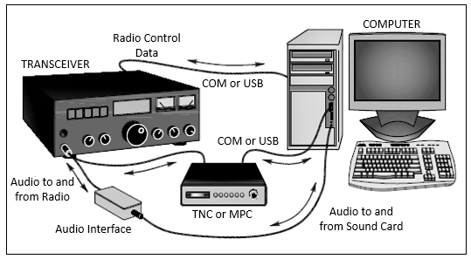
Setting Up For Digital Modes
Data interfaces are connected between the transceiver’s audio inputs and outputs and the computer’s data connections (USB or COM ports) or sound card jacks. A TNC or MPC (multiprotocol controller) converts between data and audio. An audio interface isolates the computer sound card from the radio to prevent hum.
Figure 5.10 … Typical Digital Mode Set Up

Slide 35
Setting Up For Digital Modes (cont.)
A very popular example of a “sound card mode” is FT8
If you use a sound card, you may need a digital communications interface to supply the PTT (push-to-talk) signal for keying the transmitter

Slide 36
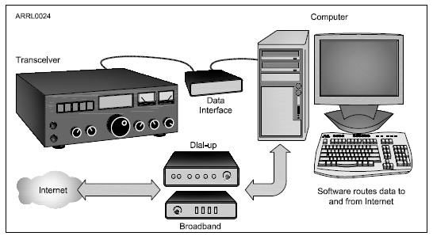
Gateways
An internet gateway station is a regular digital mode station and also runs software that relays data to and from the internet. The most common example of gateway stations are APRS gateways and Winlink RMS stations.
Figure 5.11 … Typical Gateway Set Up

Slide 37
Gateways (cont.)
The gateway shown in Figure 5.11 is a special kind of digital station that provides a connection to the internet via Amateur Radio
Most gateways are set up to forward messages
All of the rules and regulations about commercial and business-related messages and communications apply to internet gateways (follow the Amateur Radio rules)

Slide 38
Power Supplies
A solid power source is important for a clean, noise-free transmitted signal and better reception
Converts the AC input power to DC current for the radio equipment
Two main ratings:
  Output voltage
  Amount of current it can supply continuously
Radios that operate from a “12 V” supply may actually work best at the slightly higher voltage of 13.8 V typical of vehicle power systems with the engine running
If you don’t know the amount of current a radio can draw … divide output power by input voltage, then double the resulting current value and round up to the nearest amp (generally, anything above 8A will work for a 50-watt mobile rig)

Slide 39
Power Supplies (cont.)
A supply’s output voltage changes with the amount of output current
A regulated supply uses a regulator circuit to minimize the amount of voltage change
If more than just one piece of equipment is hooked up to the supply and turned on at the same time, add all of the equipment maximum current needs together

Slide 40
Mobile Power Wiring
Radio equipment can draw large currents when transmitting
If wire is too thin, its resistance (R) will create a voltage drop (V = I × R)
The resulting lower voltage at the radio can cause it to operate improperly (distorting output signal or creating interference)
General guidelines for mobile wiring …
  Fuse should be present in both the positive and negative leads of your radio
  Connect the radio’s negative lead to the negative battery terminal or where the battery ground lead is connected to the vehicle body
  Use grommets or sleeves to protect wiring from chafing or rubbing on exposed metal
  Don’t assume all metal is connected to the battery’s negative terminal

Slide 41
Batteries
Batteries are made up of one or more cells
How long will a fully-charged battery power your equipment? Check out Table 5.3 (next slide) …
  Divide the energy rating in ampere-hours (Ah) by the total current needs of the equipment. Remember to use average current draw for transceivers since you won’t be transmitting all the time.
Storage batteries are often used as an emergency power source … cautions:
  Contain strong acids that can be hazardous if spilled or allowed to leak
  Can release or vent flammable hydrogen gas, that can cause an explosion
  Accidentally short-circuiting a storage battery with a tool or faulty wiring can easily cause a fire and damage the battery

Slide 42
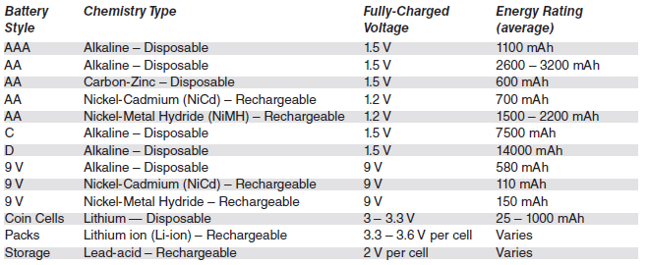
Table 5.3: Battery Types and Characteristics
(most common types used by hams)

Slide 43
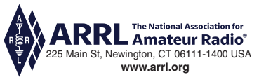
END OF MODULE 5

