Slide 1
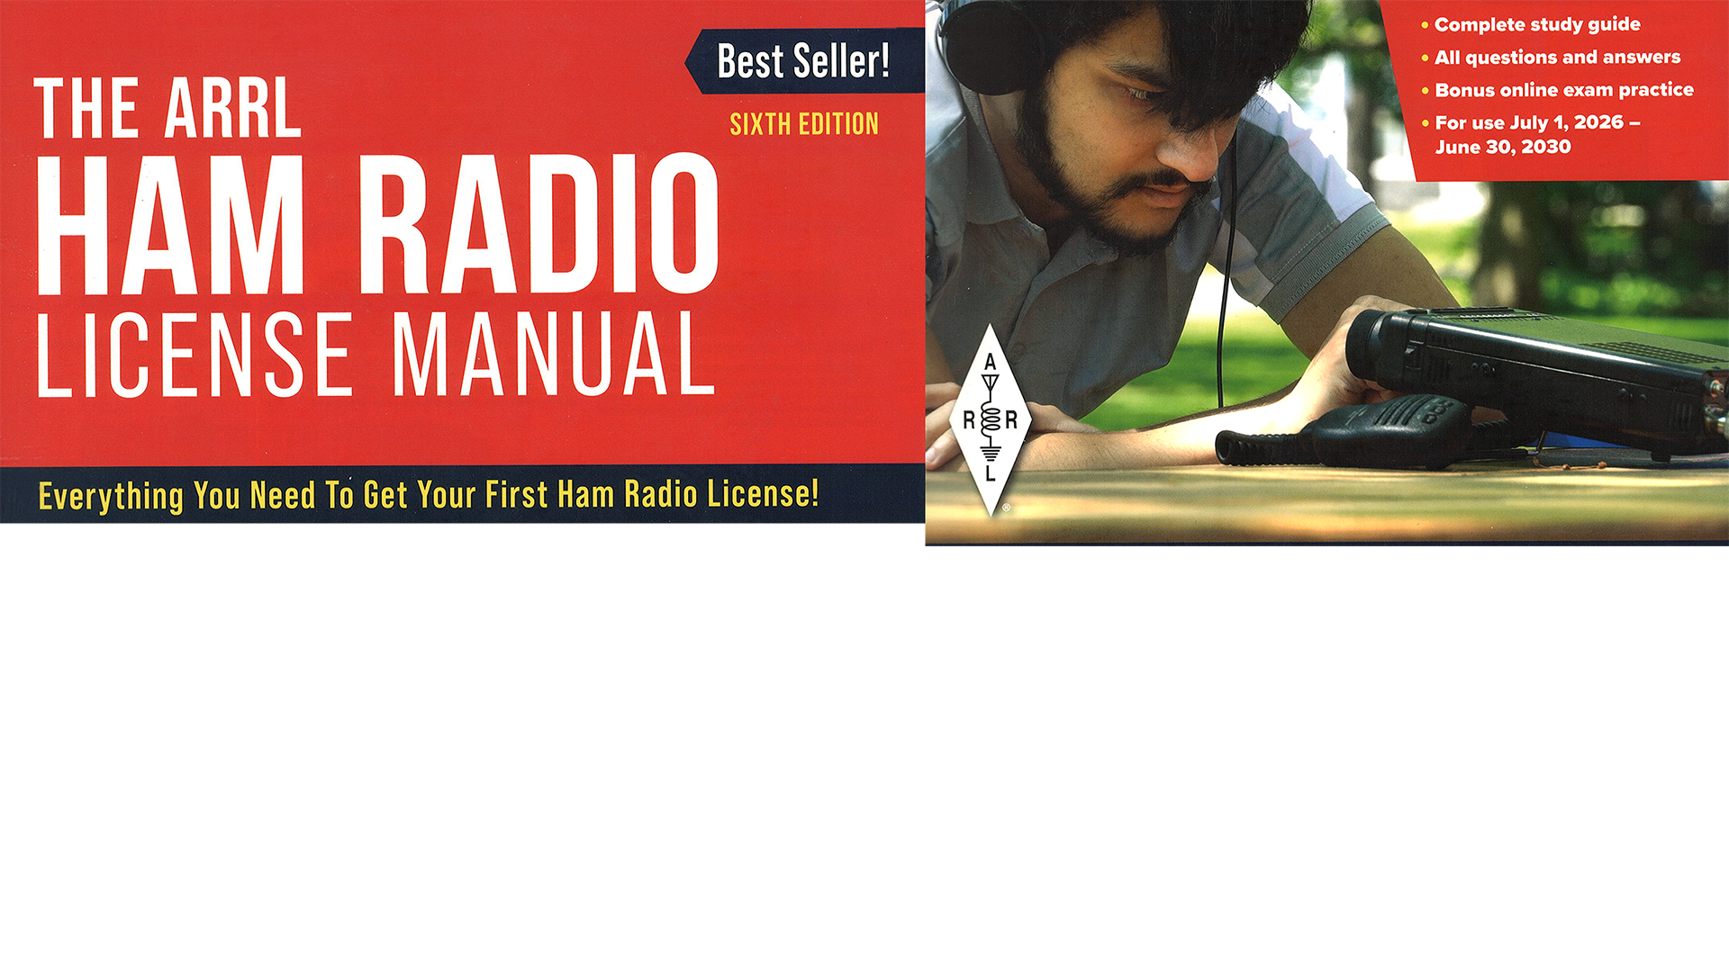
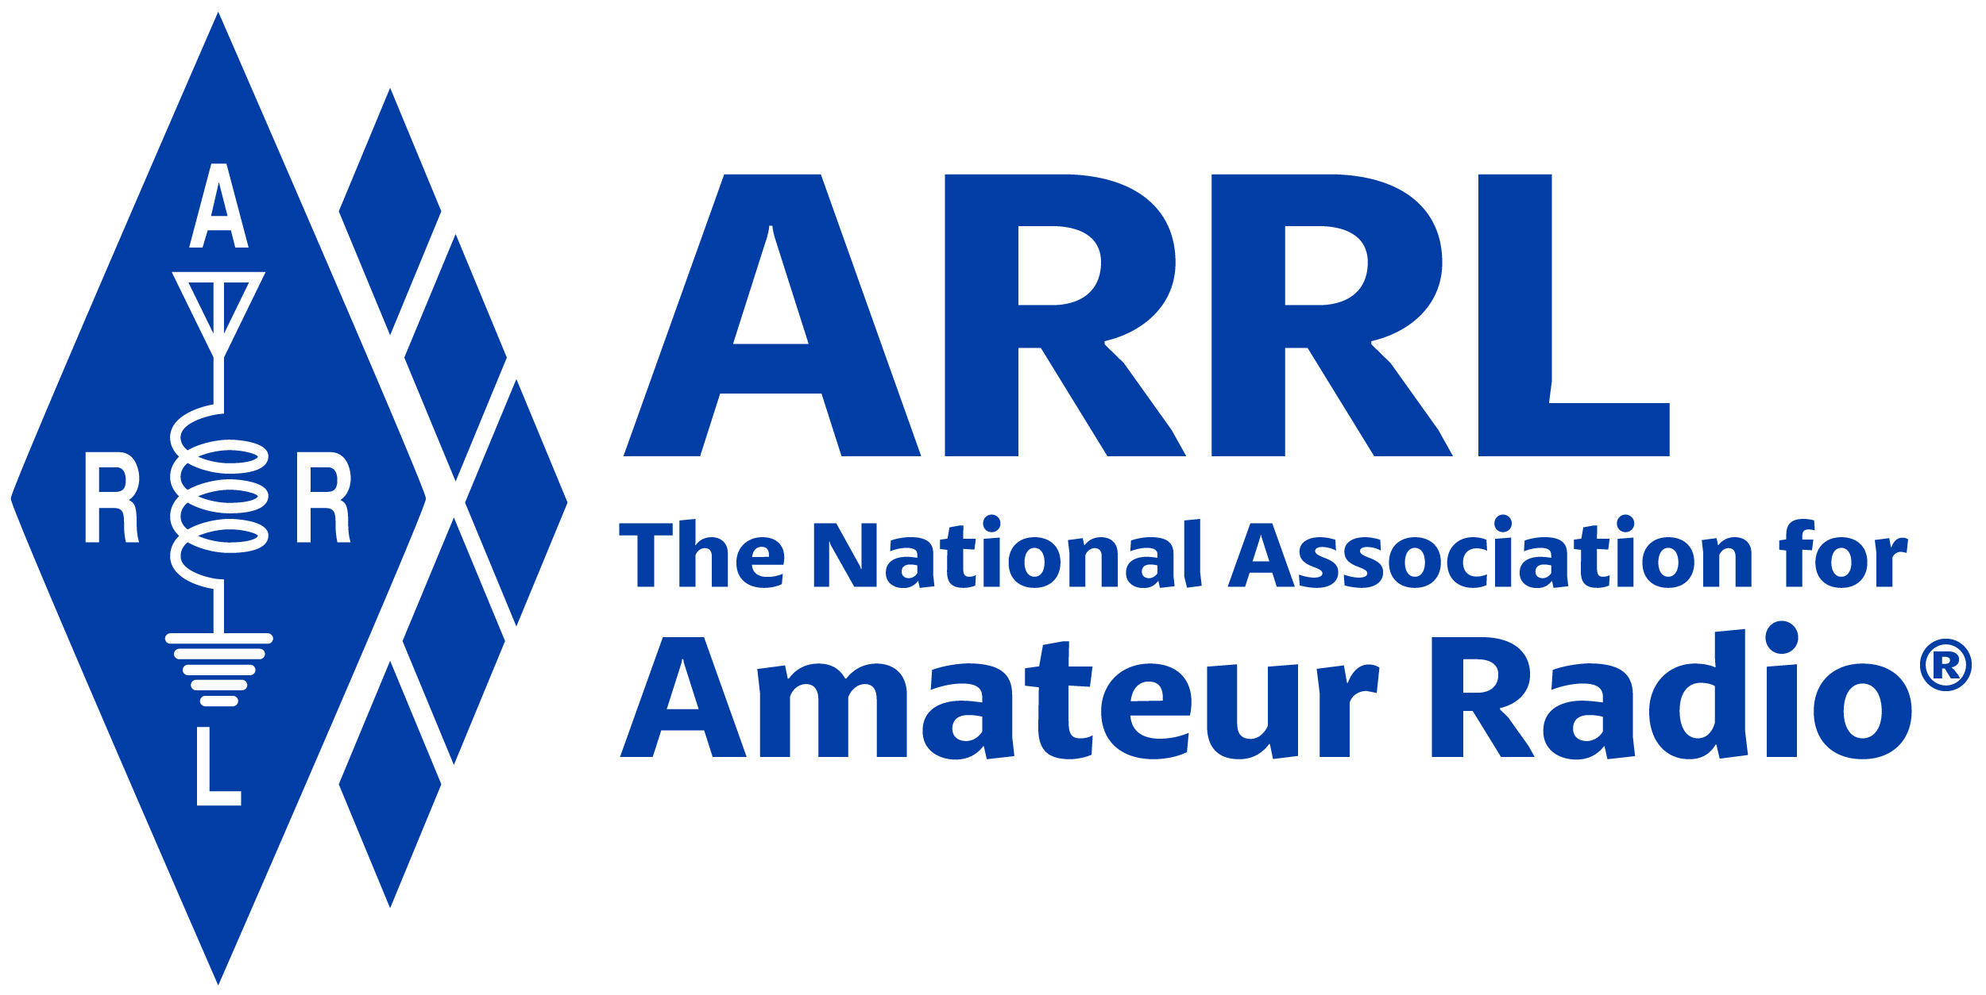
Amateur Radio Technician Exam Preparation Course

Slide 2
Amateur Radio Technician Exam Prep Course
Module 6
Communicating With Other Hams
6.1 Band Plans
6.2 Making Contacts
6.3 Using Repeaters
6.4 Nets
6.5 Communications for Public Service
6.6 Satellite Operating

Slide 3
Band Plans
Band plans are voluntary agreements designed for normal conditions (not regulations)
Amateur Radio is the only service that can tune freely and use multiple modes within their allocations
Amateur Radio Band Plan:
  www.arrl.org/band-plan
See 2 meter band plan on following slide (Table 6.1)

Slide 4
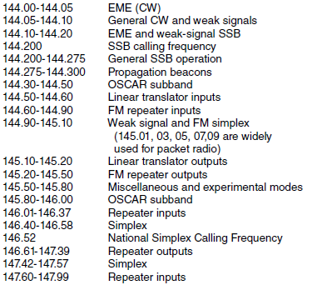
Table 6.1: 2 meter (144-148 MHz) Band Plan
2 meter and 70 cm bands are where many Technician licensees begin operating
Note the variety of activity in just one band

Slide 5
Band Plans (cont.)
HF band plans tend to be simpler than VHF and UHF because there are no repeaters
Other common uses listed in band plans …
  Beacons — Automated transmissions for listeners to tell when the band is “open” to the beacon’s location
  Weak signal — Modes that work better at lower signal strengths (CW, SSB, and some digital modes). Every amateur band from 50 MHz on up has frequencies available for CW and SSB operation.
  Satellite uplinks and downlinks —Segments of bands where signals are sent to (uplink) and received from (downlink) satellites
  Simplex — Transmitting and receiving on the same frequency
  Repeater inputs and outputs
  Control links

Slide 6
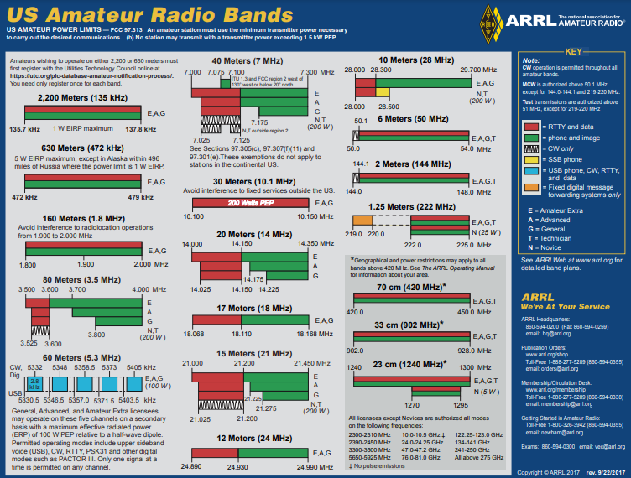
Frequency Bands Chart from arrl.org
See slide INTERPRETING THE BAND PLAN

Slide 7
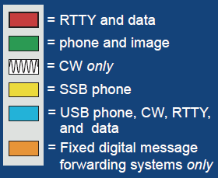
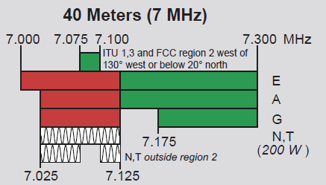
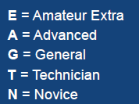
Interpreting the Band Plan
Band (frequency)
Use(s)
An EXTRA may use the 40 meter band for phone or image from 7.125 to 7.300 MHz.
License privilege(s)

Slide 8
Making Contacts on Repeaters
Before you transmit, be sure you are authorized to use that frequency and mode
Typical repeater “manners” …
  Listen so that you are aware of someone using the repeater
  Keep transmissions short
  Identify your station legally
Easiest way to attract listeners … give your call sign followed by “monitoring” … KØILP monitoring
Responding to a station looking for a contact … say the other station’s call sign once, followed by “this is” or “from,” then give your call sign … KX4IU this is KØILP

Slide 9
Making Contacts on Repeaters (cont.)
If you accidentally interrupt someone … just say “Sorry, KØILP clear” and wait for their contact to end or tune to a different repeater
What if you receive a report that your signal’s audio is strong, but distorted?
  You’re slightly off-frequency (radio control knob got bumped)
  Speaking too loudly into the microphone
  Transmitting from a bad location
  Weak or low batteries
Repeaters often add a short courtesy beep to the retransmitted signal when the transmitting station’s signal disappears
  Becomes the “over” cue to other stations to start speaking (although saying OVER is common and acceptable)

Slide 10
Making Contacts on Simplex Channels
Simplex channels are conveniently located between bands of repeater input and output channels
It’s often quite easy to make contact directly, without use of a repeater … avoids occupying or “tying up” a repeater
Many radios have a reverse split function that swaps transmit and receive frequencies, enabling you to listen for the other station on the repeater’s input frequency
The national simplex calling frequency on 2 meters is 146.52 MHz
  70 cm it is 446.00 MHz
  Most amateur bands have a calling frequency (www.arrl.org/band-plan)

Slide 11
Making Contacts: SSB, CW, and DIGITAL
Starting contacts is different on these modes than on repeaters that use fixed channels … call must be long enough to attract attention
Done by calling CQ (means “I am calling any station.”)
  The station calling CQ sends or says “CQ” several times followed by their call sign … CQ CQ CQ, this is KØILP Kilo Zero India Lima Papa calling CQ and standing by
  On CW or Digital: CQ CQ CQ DE KØILP KØILP KØILP K
Before you call CQ you should do three things …
  Be sure the frequency is one your license privileges authorize you to use
  Listen to be sure the frequency is not already in use
  Make a short transmission asking if the frequency is in use
Responding to a station calling CQ …
  Give the CQing station’s call sign (KX4IU) once then yours (KØILP) once (using phonetics) … KX4IU this is Kilo Zero India Lima Papa

Slide 12
Q-Signals
Q-signals are a system of radio shorthand (abbreviations for common information) developed from old telegraphy codes
Although developed for use by Morse operators, their use is also common on phone/voice
Table 6.2 lists the most common Q-signals

Slide 13
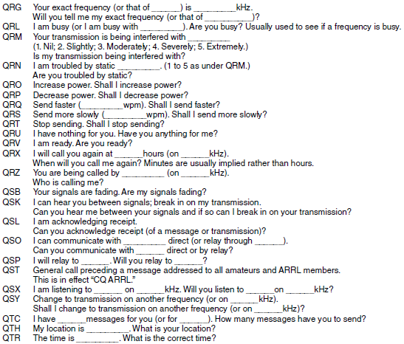
Table 6.2: Q-Signals
Take the form of a question only when followed by a question mark.

Slide 14
DXing and Contesting
DX stands for distant station
  Means thousands of miles on HF (and occasionally 6 meters)
  Beyond the radio horizon on VHF/UHF
Best done on SSB or CW because of the efficiency of those modes
Radio contests are held in which the competitors try to make as many short contacts as possible in a fixed period of time
During contesting send only the minimum information needed to identify your station and complete the exchange
Contesting info available at:
  http://www.arrl.org/contest-calendar

Slide 15
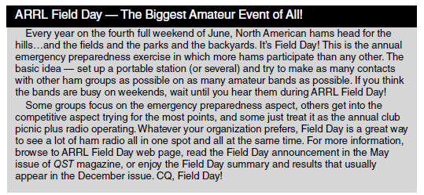
Popular DXing Event
www.arrl.org/field-day

Slide 16
Fox Hunting & Direction Finding
A different and more physical type of contest is known as foxhunting
Involves hiding and finding hidden transmitters
Trains hams to find downed aircraft, lost hikers, and sources of interference or jamming
You can get started with a portable radio with a signal strength indicator and a handheld or portable directional antenna (Yagi)
A similar event is radio direction finding
  A hybrid of the radio fox hunt using orienteering skills to navigate outdoors with map and compass

Slide 17
Video
Two primary means of exchanging pictures or video in real-time
  Amateur television (ATV) on the UHF bands at 430 MHz and higher
  Fast-scan color television signals (NTSC … National Television System Committee)
    Slow-scan television (SSTV) sends still signals
More info on amateur radio imaging at:
  www.arrl.org/atv-fast-scan-amateur-television
  www.hamuniverse.com/atvfastscantv.html

Slide 18
PRACTICE QUESTIONS

Slide 19
Where may SSB phone be used in amateur bands above 50 MHz?
Only in sub-bands allocated to General class or higher licensees
Only on repeaters
In at least some segment of all these bands
On any band if the power is limited to 25 watts
T1B10 C 97.305(c) 6-1

Slide 20
What is a band plan, beyond the privileges established by the FCC?
A voluntary guideline for using different modes or activities within an amateur band
A list of operating schedules
A list of available net frequencies
A plan devised by a club to indicate frequency band usage
T2A10 A 6-1

Slide 21
What term describes an amateur station that is transmitting and receiving on the same frequency?
Full duplex
Diplex
Simplex
Multiplex
T2A11 C 6-1

Slide 22
What is an appropriate way to call another station on a repeater if you know the other station's call sign?
Say "break, break," then the other station’s call sign, followed by your call sign
Say the station's call sign, then identify with your call sign
Say "CQ" three times, then the other station's call sign, followed by your call sign
Wait for the station to call CQ, then answer with your call sign
T2A04 B 6-4

Slide 23
Which of the following is a customary way to indicate a station is listening on a repeater and looking for a contact?
“CQ CQ” followed by the repeater’s call sign
The station’s call sign followed by the word “listening”
The repeater’s call sign followed by the station’s call sign
“QSY” followed by your call sign
T2A09 B 6-4

Slide 24
What might be a problem if you receive a report that your audio signal through an FM repeater is distorted or unintelligible?
Your transmitter is slightly off frequency
You are speaking too loudly or too close to the microphone
You are in a bad location
All these choices are correct
T7B10 D 6-4

Slide 25
What is the national calling frequency for FM simplex operations in the 2-meter band?
146.520 MHz
145.000 MHz
432.100 MHz
446.000 MHz
T2A02 A 6-6

Slide 26
What is the purpose of the reverse function on a VHF/UHF transceiver?
To reduce power output
To increase power output
To listen on a repeater’s input frequency
To listen on a repeater’s output frequency
T2B01 C 6-6

Slide 27
Why are simplex channels designated in the VHF/UHF band plans?
So stations within range of each other can communicate without tying up a repeater
For contest operation
For working DX only
So stations with simple transmitters can access the repeater without automated offset
T2B09 A 6-6

Slide 28
How should you respond to a station calling CQ?
Transmit "CQ" followed by the other station’s call sign
Transmit your call sign followed by the other station’s call sign
Transmit the other station’s call sign followed by your call sign
Transmit a signal report followed by your call sign
T2A05 C 6-6

Slide 29
What is the meaning of the procedural signal “CQ”?
A shortened form of the term “Contest QSO”
“Communication Quality,” used to indicate transmitted audio clarity
Only the called station should transmit
Calling any station
T2A08 D 6-6

Slide 30
Which Q signal indicates that you are receiving interference from other stations?
QRM
QRN
QTH
QSB
T2B10 A 6-7

Slide 31
Which Q signal indicates that you are changing frequency?
QRU
QSY
QSL
QRZ
T2B11 B 6-7

Slide 32
What operating activity involves contacting as many stations as possible during a specified period?
Simulated emergency exercises
Net operations
Hidden transmitter hunts
Contesting
T8C03 D 6-7

Slide 33
Which of the following is good practice when contacting another station in a contest?
Signing only the last two letters of your call if there are many other stations calling
Contacting the station twice to be sure that you are in his log
Sending only the minimum information needed for proper identification and the contest exchange
Adding “Please copy” before your exchange
T8C04 C 6-7

Slide 34
What is a grid locator?
A letter-number designator assigned to a geographic location
A letter-number designator assigned to an azimuth and elevation
An instrument for locating faults in power amplifiers
An instrument for radio direction finding
T8C05 A 6-8

Slide 35
What is meant by the term "NTSC?"
A digital transmission standard for encrypting data
A special mode for satellite uplink
An analog fast-scan color TV signal
A frame compression scheme for TV signals
T8D04 C 6-9

Slide 36
Which of the following methods is used to locate sources of noise interference or jamming?
Echolocation
Doppler radar
Radio direction finding
Phase locking
T8C01 C 6-10

Slide 37
Which of these items would be useful for a hidden transmitter hunt?
Calibrated SWR meter
A directional antenna
A directional wattmeter
All these choices are correct
T8C02 B 6-10

Slide 38
Using Repeaters
Technicians commonly make contacts through repeaters
To find repeaters in your area, you’ll need a listing sorted by area …
  ARRL Repeater Directory (www.arrl.org)
  Repeater Book (www.repeaterbook.com)
You can use the scanning function of your radio to listen for activity on repeater or simplex channels
To access a repeater you will need to know three things …
  Repeater transmitter’s output or transmit frequency
  Repeater receiver’s input or receive frequency
  Frequency of any access control tones

Slide 39
Repeater Offset (Shift)
To listen to a repeater, tune to its output frequency
To send a signal through the repeater, you must transmit on the repeater’s input frequency
The difference between repeater input and output frequencies is called the repeater’s offset or shift
  For 2 meters, usually ±600 kHz
  For 70 centimeters, usually ±5 MHz

Slide 40
Linked Repeater Systems & Access Tones
To extend their range, repeaters sometimes use remote receivers
Repeaters can also be linked to other repeaters (by sharing the signals each receives and retransmitting them)
Most repeaters won’t pass a signal from the receiver to the transmitter for retransmission unless it contains an access tone
  Also called Continuous Tone Coded Squelch System (CTCSS), PL (for Private Line, the Motorola trade name) or sub-audible
  Your radio’s operating manual will explain how to select and activate the tone
    There may be several tone options, such as tone squelch and digital code squelch (DCS)
Troubleshooting repeaters … If you can hear a repeater’s signal, but it can’t hear you …
  Make you’re sure you are using the right offset
  Make sure you have your radio set up to use the right type or frequency of access tone (CTCSS)
  Make sure your radio’s digital code squelch settings are correct (DCS)

Slide 41
PRACTICE QUESTIONS

Slide 42
What does the scanning function of an FM transceiver do?
Checks incoming signal deviation
Prevents interference to nearby repeaters
Tunes through a range of frequencies to check for activity
Tunes through a range of frequencies to determine the antenna’s resonant frequency
T4B05 C 6-10

Slide 43
What is a common repeater frequency offset in the 2-meter band?
Plus or minus 5 MHz
Plus or minus 600 kHz
Plus or minus 500 kHz
Plus or minus 1 MHz
T2A01 B 6-11

Slide 44
What is a common repeater frequency offset in the 70-centimeter band?
Plus or minus 5 MHz
Plus or minus 600 kHz
Plus or minus 500 kHz
Plus or minus 1 MHz
T2A03 A 6-11

Slide 45
What does the term "repeater offset" mean?
The difference between a repeater’s transmit and receive frequencies
The repeater has a time delay to prevent interference
The approximately half-second delay to allow for the “squelch tail” to be removed
The fee charged by the repeater owner or club to provide for maintenance
T2A07 A 6-11

Slide 46
Which of the following describes a linked repeater network?
A network of repeaters in which signals received by one repeater are transmitted by all the repeaters in the network
A single repeater with more than one receiver
Multiple repeaters with the same control operator
A system of repeaters linked by APRS
T2B03 A 6-12

Slide 47
What term describes the use of a sub-audible tone transmitted along with normal voice audio to open the squelch of a receiver?
Carrier squelch
Tone burst
DTMF
CTCSS
T2B02 D 6-12

Slide 48
Which of the following could be the reason you are unable to access a repeater whose output you can hear?
Improper transceiver offset
You are using the wrong CTCSS tone
You are using the wrong DCS code
All these choices are correct
T2B04 D 6-12

Slide 49
Digital Repeater Systems
Ham radio and the Internet can link repeaters and communicate nearly anywhere on Earth … some of these systems include:
  IRLP (Internet Radio Linking Project)
  EchoLink
  WIRES II — a proprietary system of the Yaesu company
  D-STAR — a system based on the public D-STAR standard
  DMR — Digital Mobile Radio
IRLP and EchoLink use VoIP (Voice over Internet Protocol) technology
EchoLink uses VoIP to enable stations to transmit through an internet-connected repeater without using a radio to initiate the transmission (a call sign & proof of license are required)

Slide 50
Digital Repeater Systems (cont.)
IRLP and EchoLink contacts differ from a regular repeater contacts … initiating station must know the repeater control code to request an IRLP connection … a sequence of DTMF or Dual-tone Multi-Frequency tones
WIRES II uses voice-only standard developed by radio manufacturer Yaesu
D-STAR combines digital voice and data communications
DMR is a technique for time-multiplexing two digital voice signals on a single 12.5 kHz repeater channel … digital codes called color codes are used to access a specific repeater, similar to CTCSS or PL access tones on an analog FM repeater
  By programming your radio with those IDs and codes, you can join the group and your audio will be shared with all other members of the group
  Talk groups allow groups of users to share a channel at different times without being heard by other users on the channel … data are contained in a code plug computer file

Slide 51
Digital Repeater Systems (cont.)
You don’t need different radios for each digital voice system … hot spots are used that link your digital transceiver to the internet, and software in the hot spot makes the connection
WIRES II/System Fusion, D-STAR, DMR, P25, and NXDN all use talk groups in one form or another
  To join a talk group, you’ll need to know the group’s identification code or number
  You’ll also have to enter your own identification code (and call sign for D-STAR) into the transceiver so the system knows who you are

Slide 52
Nets
In the early days of radio, nets helped stations meet on the air to share news and messages
Today’s nets include support for emergency communications and public service activities
Nets usually have two purposes:
  Pass emergency messages
  Coordinate reporting and response activities
Net messages are called traffic, which often have built-in routing information to get the message to the right place
Exchanging messages is called traffic handling
Between activations, emergency nets are activated for practice and to conduct training exercises

Slide 53
Net Structure and Participation
A Net Control Station (NCS) directs the net by calling it to order and directing communications between stations checking into the net
A station with emergency traffic should break in at any time
Do not transmit unless you are specifically requested or authorized to do so or a request is made for capabilities or info that you can provide

Slide 54
Exchanging Messages on the Net
The most important job during emergency and disaster net operation is the ability to accurately relay or pass messages
Messages are often formatted as radiograms
The preamble or header contains bits of information about the message so that it can be handled and tracked appropriately (see following slide for header details)
Following the preamble is the text of the radiogram … to ensure accuracy, names are spelled out using standard phonetics

Slide 55
Message Headers Contain …
Number —number assigned by the station that creates the radiogram
Precedence — a description of the nature of the radiogram
Handling Instructions
Station of Origin — the sending station’s call sign
Check — the number of words and word equivalents in the radiogram
Place of Origin — the name of the town from which the radiogram started
Time and Date
Address — the complete name, street and number, city and state to whom the radiogram is going

Slide 56
PRACTICE QUESTIONS

Slide 57
What type of signaling to a repeater uses two simultaneous audio tones?
DTMF
CTCSS
GMRS
D-STAR
T2B06 A 6-13

Slide 58
How can you join a digital repeater’s “talkgroup”?
Register with the local Frequency Coordinator
Register with the digital repeater control operator
Program your radio with the group’s ID or code
Program your radio with the DTMF tone used by the talkgroup
T2B07 C 6-13

Slide 59
What is the digital color code used on DMR repeater systems?
An access code which must be programmed into a DMR transmitter to access a specific repeater
A code which automatically programs the repeater offset to a frequency chosen by the user
A code which identifies the specific CODEC being used so that the repeater can properly decode the audio
A code transmitted by the repeater to indicate health and status of the equipment
T2B12 A 6-13

Slide 60
What function does a digital mode hotspot perform for nearby transceivers?
Communication with a digital voice or data network
FT8 digital communications via AFSK using a smartphone connected to the internet
RTTY encoding and decoding without a computer
High-speed digital communications for meteor scatter
T4A10 A 6-13

Slide 61
What is a DMR “code plug”?
An adapter cable used to connect a DMR radio to a computer for internet access
Configuration data loaded onto your radio to access repeaters and talkgroups
An upgrade to DMR programming software provided by the radio manufacturer to accommodate new radio models
A Coder-Decoder (CODEC) that converts analog voice data to DMR digital data and vice versa
T4B07 B 6-13

Slide 62
How is a specific group of stations selected on a DMR digital voice transceiver?
By retrieving the frequencies from transceiver memory
By enabling the group’s CTCSS tone
By entering the group’s identification code
By inserting a five-pin, pre-programmed code plug
T4B09 C 6-13

Slide 63
Which of the following must be programmed into a D-STAR digital transceiver before transmitting?
Your call sign
Your output power
The codec type being used
All these choices are correct
T4B11 A 6-13

Slide 64
How is over the air access to Internet Radio Linking Project (IRLP) nodes accomplished?
By obtaining a password that is sent via voice to the node
By using Dual-Tone Multi-Frequency (DTMF) signals
By entering the proper internet password
By using Continuous Tone-Coded Squelch System (CTCSS) tone codes
T8C06 B 6-13

Slide 65
What is Voice Over Internet Protocol (VoIP)?
A set of rules specifying how to identify your station when linked over the internet to another station
A technique employed to “spot” DX stations via the internet
A technique for measuring the modulation quality of a transmitter using remote sites monitored via the internet
A method of delivering voice communications over the internet using digital techniques
T8C07 D 6-13

Slide 66
What is the Internet Radio Linking Project (IRLP)?
A technique to connect amateur radio systems, such as repeaters, via the internet
A system for providing access to websites via amateur radio
A system for informing amateurs in real time of the frequency of active DX stations
A technique for measuring signal strength of an amateur transmitter via the internet
T8C08 A 6-13

Slide 67
Which of the following protocols enables an amateur station to transmit through a repeater without using a radio to initiate the transmission?
IRLP
D-STAR
DMR
EchoLink
T8C09 D 6-13

Slide 68
What is required before using the EchoLink system?
Complete the required EchoLink training
Purchase a license to use the EchoLink software
Register your call sign and provide proof of license
At least a General Class license
T8C10 C 6-13

Slide 69
What is FT8?
A wideband FM voice mode
A digital mode capable of low signal-to-noise operation
An eight-channel multiplex mode for FM repeaters
A digital slow-scan TV mode with forward error correction and automatic color compensation
T8D02 B 6-14

Slide 70
Which of the following describes DMR?
A technique for time-multiplexing two digital voice signals on a single 12.5 kHz repeater channel
An automatic position tracking mode for FM mobiles communicating through repeaters
An automatic computer logging technique for hands-off logging when communicating while operating a vehicle
A digital technique for transmitting on two repeater inputs simultaneously for automatic error correction
T8D07 A 6-14

Slide 71
What does the term “traffic” refer to in net operation?
Formal messages exchanged by net stations
The number of stations checking in and out of a net
Operation by mobile or portable stations
A count of the number of activations of the net each month
T2C05 A 6-16

Slide 72
Which of the following is a “talkgroup”?
A group of amateur radio operators who share email on a specific amateur radio topic
An identifier used by DMR to organize radio traffic so that those who want to hear the group aren’t bothered by other radio traffic
The members of a net organized for amateur radio operators with a specific common interest
A method of automatically alerting all group members to the frequency where any member is transmitting
T2B14 B 2026-2030

Slide 73
Which of the following is standard practice when you participate in a net?
When first responding to the net control station, transmit your call sign, name, and address as in the FCC database
Record the time of each of your transmissions
Unless you are reporting an emergency, transmit only when directed by the net control station
All these choices are correct
T2C07 C 6-16

Slide 74
Which of the following are typical duties of a Net Control Station?
Choose the regular net meeting time and frequency
Ensure that all stations checking into the net are properly licensed for operation on the net frequency
Call the net to order and direct communications between stations checking in
All these choices are correct
T2C02 C 6-16

Slide 75
What technique is used to ensure that voice messages containing unusual words are received correctly?
Send the words by voice and Morse code
Use the Q-code “QSR” to ask the receiving station to repeat the words back
Spell the words using a standard phonetic alphabet
All these choices are correct
T2C03 C 6-17

Slide 76
Which of the following relays messages using email addresses based on amateur callsigns?
Winlink
FT8
PSK31
AMTOR
T2C08 A 6-17

Slide 77
What information is contained in the preamble of a formal traffic message?
The email address of the originating station
The address of the intended recipient
The telephone number of the addressee
Information needed to track the message
T2C10 D 6-17

Slide 78
What is meant by “check” in a radiogram header?
The number of words or word equivalents in the text portion of the message
The call sign of the originating station
A list of stations that have relayed the message
A box on the message form that indicates that the message was received and/or relayed
T2C11 A 6-17

Slide 79
Communications for Public Service
ARES & RACES
The two largest Amateur Radio emergency response organizations are ARES (Amateur Radio Emergency Service) and RACES (Radio Amateur Civil Emergency Service)
ARES consists of licensed amateurs who have registered their qualifications and equipment for duty in the public service
  Sponsored by ARRL
RACES is a special part of the FCC Part 97 Amateur service to provide civil defense communications during national emergencies

Slide 80
Threats to Life and Property
FCC Part 97.403 states …
“No provision of these rules prevents the use by an amateur station of any means of radiocommunication at its disposal to provide essential communication needs in connection with the immediate safety of human life and immediate protection of property when normal communication systems are not available.”
In an emergency, you may use any means possible to address that risk, including operating outside the frequency privileges of your license.
You are bound by FCC rules at all times, even if using your radio in support of a public safety agency.

Slide 81
Satellite Operating
International Space Station
  Most astronauts hold an amateur radio license
  Any amateur licensed to use 2 meter and 70 cm bands can communicate with ISS (this means Technician)
  To call the space station, call sign NA1SS, transmit on 145.990 MHz and listen on 145.800 MHz
Amateurs have built more than 50 satellites since 1961
Amateur satellites are nicknamed OSCAR for Orbiting Satellite Carrying Amateur Radio
A Technician can communicate through a satellite listening for uplink signals on 2 meters and transmitting on a 10 meter downlink frequency even though a Technician is not permitted to transmit on 10 meters

Slide 82
Satellite Definitions
Apogee — The point of a satellite’s orbit that is farthest from Earth
Beacon — A signal from the satellite containing information about a satellite
Doppler shift — An observed change in signal frequency caused by relative motion between the satellite and the Earth station
Elliptical orbit — An orbit with a large difference between apogee and perigee
LEO — A satellite in low-Earth orbit
Perigee — The point of a satellite’s orbit that is nearest the Earth
Space station — Defined by the FCC as an amateur station located more than 50 km above the Earth’s surface
Spin fading — Signal fading caused by rotation of the satellite and its antennas

Slide 83
Tracking a Satellite
A satellite tracking program is used to determine satellite schedules
The tracking program needs certain bits of data about the satellite’s orbit called the Keplerian elements
The software can provide real-time maps of the satellite’s location, the trajectory the satellite will follow across the sky, and the amount of Doppler shift the signals will experience

Slide 84
Operating via Satellites
Most satellites only have one operational mode
  Specified as two letters separated by a slash
  The uplink for a satellite in U/V mode is in the UHF band (70 cm) and a downlink is in the VHF band (2 meters)
  Satellites can use any amateur mode … most common are SSB, FM, CW, and data
You can tell when the satellite is within range by listening for the beacon (transmitted via CW or RTTY)
This telemetry data from the satellite contains information on the health and status of the satellite
Anyone can receive satellite telemetry!
Use the minimum amount of transmitter power to contact satellites, since their relay transmitter power is limited by their solar panels and batteries (your signal on the satellite downlink should be about the same strength as that of the satellite’s beacon)

Slide 85
PRACTICE QUESTIONS

Slide 86
Besides an FCC-issued amateur operator license, what is required to be the control operator of a Radio Amateur Civil Emergency Service (RACES) Station?
A written recommendation by the local ARRL Emergency Coordinator
Membership in the Amateur Radio Emergency Service (ARES)
Certification of current enrollment by a civil defense organization
Nothing
T1A10 C 97.3(a)(38),97.407 6-18

Slide 87
What is RACES?
An emergency organization combining amateur radio and citizens band operators and frequencies
An international radio experimentation society
A radio contest held in a short period, sometimes called a “sprint”
An FCC Part 97 amateur radio service for civil defense communications during national emergencies
T2C04 D 6-18

Slide 88
Which of the following requires certification by a civil defense agency?
ARES
RACES
MARS
SKYWARN
T2C12 B 2026-2030

Slide 89
What is the Amateur Radio Emergency Service (ARES)?
A group of licensed amateurs who have voluntarily registered their qualifications and equipment for communications duty in the public service
A group of licensed amateurs who are members of the military and who voluntarily agreed to provide message handling services in the case of an emergency
A training program that provides licensing courses for those interested in obtaining an amateur license to use during emergencies
A training program that certifies amateur operators for membership in the Radio Amateur Civil Emergency Service
T2C06 A 6-18

Slide 90
When do the FCC Part 97 Amateur Radio Service rules NOT apply to the operation of an amateur station?
When operating under RACES rules
When operating under FEMA rules
When operating under ARES rules
FCC rules always apply
T2C01 D 97.103(a) 6-19

Slide 91
Are amateur station control operators ever permitted to operate outside the frequency privileges of their license class?
No
Yes, but only when part of a FEMA emergency plan
Yes, but only when part of a RACES emergency plan
Yes, but only in situations involving the immediate safety of human life or protection of property
T2C09 D 6-19

Slide 92
Which of the following U.S. amateur radio operators are allowed to contact the International Space Station (ISS) on VHF bands?
Only amateurs with a General class or higher license
Any amateur with a Technician class or higher license
Only amateurs with a General class or higher license, and NASA approval
Any amateurs with a Technician class or higher license, and NASA approval
T1B02 B 97.301,97.207(c) 6-22

Slide 93
Who may be the control operator of a station communicating through an amateur satellite or space station?
Only an Amateur Extra Class operator
A General class or higher licensee with a satellite operator certification
Only an Amateur Extra Class operator who is also an AMSAT member
Any amateur allowed to transmit on the satellite uplink frequency
T1E02 D 97.301,97.207(c) 6-23

Slide 94
What is the FCC Part 97 definition of a space station?
Any satellite orbiting Earth
A manned satellite orbiting Earth
An amateur station located more than 50 km above Earth's surface
An amateur station using amateur radio satellites for relay of signals
T1A07 C 97.3(a)(41) 6-23

Slide 95
What is a satellite beacon?
The primary transmit antenna on the satellite
An indicator light that shows where to point your antenna
A reflective surface on the satellite
A transmission from a satellite that contains status information
T8B05 D 6-23

Slide 96
What is Doppler shift in reference to satellite communications?
A change in the satellite orbit
A mode where the satellite receives signals on one band and transmits on another
An observed change in signal frequency caused by relative motion between the satellite and Earth station
A special digital communications mode for some satellites
T8B07 C 6-23

Slide 97
What causes spin fading of satellite signals?
Circular polarized noise interference radiated from the sun
Rotation of the satellite and its antennas
Doppler shift of the received signal
Interfering signals within the satellite uplink band
T8B09 B 6-23

Slide 98
What does the term LEO mean in reference to communication satellites?
Low Energy Orbit, which conserves battery power
Low Elevation Orbit, which appears close to the horizon from the earth station
Low Equilibrium Orbit, which has a slightly unstable period
Low Earth Orbit, which has a period of around 100 minutes
T8B10 D 6-23

Slide 99
Which of the following are provided by satellite tracking programs?
Maps showing the real-time position of the satellite track over Earth
The time, azimuth, and elevation of the start, maximum altitude, and end of a pass
The apparent frequency of the satellite transmission, including effects of Doppler shift
All these choices are correct
T8B03 D 6-24

Slide 100
Which of the following are inputs to a satellite tracking program?
The satellite transmitted power
The Keplerian elements
The last observed time of zero Doppler shift
All these choices are correct
T8B06 B 6-24

Slide 101
What telemetry information is typically transmitted by satellite beacons?
The signal strength of received signals
Time of day accurate to plus or minus 1/10 second
Health and status of the satellite
All these choices are correct
T8B01 C 6-24

Slide 102
What is the impact of using excessive effective radiated power on a satellite uplink?
Possibility of commanding the satellite to an improper mode
Blocking access by other users
Overloading the satellite batteries
Possibility of rebooting the satellite control computer
T8B02 B 6-24

Slide 103
What mode of transmission is commonly used by amateur radio satellites?
SSB
FM
CW/data
All these choices are correct
T8B04 D 6-24

Slide 104
What does it mean if a satellite is operating in U/V mode?
The satellite uplink is in the 15-meter band and the downlink is in the 10-meter band
The satellite uplink is in the 70-centimeter band and the downlink is in the 2-meter band
The satellite operates using ultraviolet frequencies
The satellite frequencies are usually variable
T8B08 B 6-24

Slide 105
Who is permitted to receive telemetry from an amateur radio satellite?
Anyone
Only the satellite control operator
Only the control operator or a licensed radio amateur who has received the encryption key from the control operator
Only a licensed radio amateur who has received the encryption key from AMSAT
T8B11 A 6-24

Slide 106
Which of the following is a way to determine whether your satellite uplink power into a linear transponder satellite is neither too low nor too high?
Check your signal strength report in the telemetry data
Listen for distortion on your downlink signal
Your signal strength on the downlink should be about the same as the beacon
Compare your signal to others on the downlink using an internet SDR receiver
T8B12 C 6-24

Slide 107
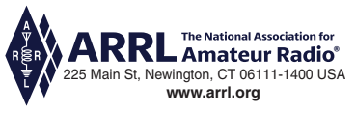
END OF MODULE 6

