Slide 1
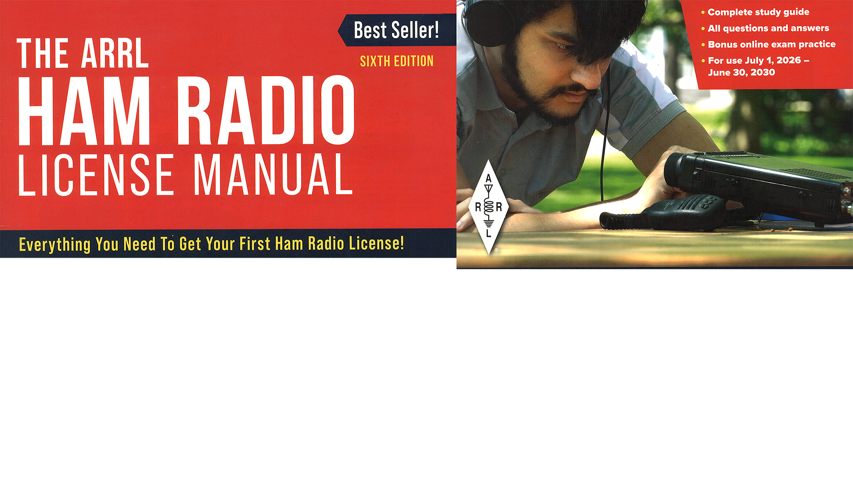
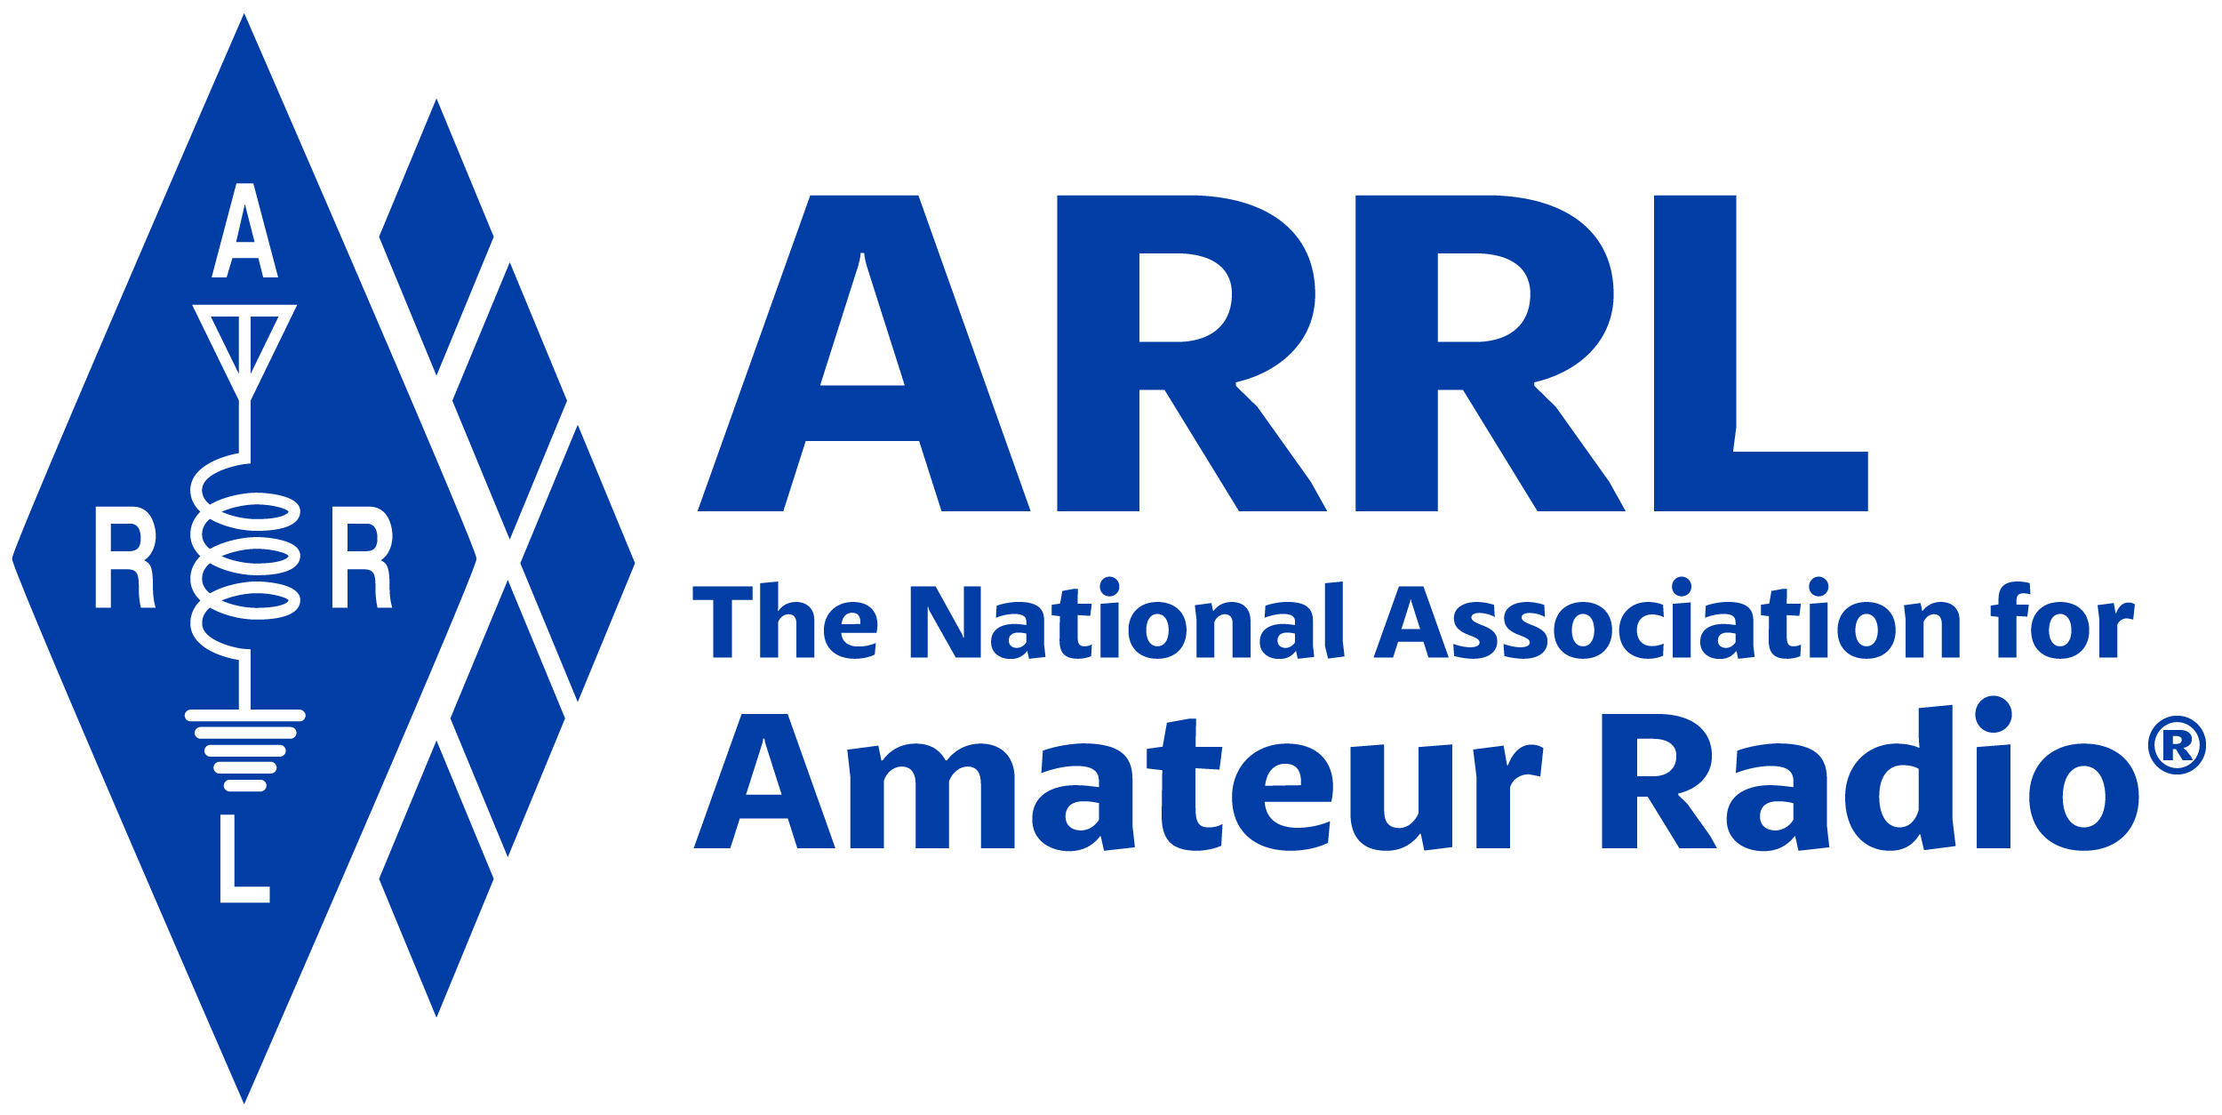
Amateur Radio Technician Exam Preparation Course

Slide 2
Amateur Radio Technician Exam Prep Course
Module 7
Licensing Regulations
7.1 Licensing Terms
7.2 Bands and Privileges
7.3 International Rules
7.4 Call Signs

Slide 3
Licensing Terms
The Federal Communications Commission or FCC makes and enforces the rules for the Amateur Radio service in the United States
Detailed list of rules & regulations at …
  http://www.arrl.org/part-97-amateur-radio
Amateur radio is non-commercial … hams aren’t allowed to be paid for their services (with a few exceptions) … voluntary
Hams use various events to train to operate radio equipment in useful ways and to keep their emergency response skills sharp, such as …
  Competitive operating events, chasing awards, and station-building

Slide 4
Types and Classes of Licenses
An Amateur Radio license consists of two parts — an operator license and a station license
  Operator license gives you permission to operate an amateur station
  Station license authorizes you to have an amateur station
  Each person can have only ONE such license
There are three classes of Amateur Radio licenses being granted today: Technician, General, and Amateur Extra
  Each carries a different set of frequency and operating privileges
Clubs can also be license holders
  Clubs must have at least FOUR members to be organized … see rule 97.5 (b)

Slide 5
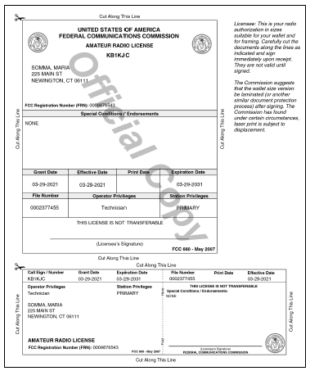
Sample license
Figure 7.1 — An FCC Amateur Radio license is both an operator and a station license. The printed license shown here has two sections: one for posting in your station and one to carry with you. For information on obtaining a copy of your license, see www.arrl.org/obtain-license-copy.

Slide 6
Examinations
Amateur volunteers run their own exam sessions
  Volunteer Examiner Coordinators (VEC): An organization or group that administers exams
  Volunteer Examiner (VE): An individual amateur radio operator that actually gives the exam (reports to a VEC) … General class or higher (however, Technicians can assist)
Exams are referred to by elements …
  Element 2 … Technician (35 questions, 26 required to pass)
  Element 3 … General (35 questions, 26 required to pass)
  Element 4 … Extra (50 questions, 37 required to pass)
Test forms are filed with the FCC by the VEC administering the exam
Once your information shows up in the FCC ULS database, you are fully authorized to operate

Slide 7
Term of License and Renewal
Amateur licenses are good for a 10-year term, renewable without reexamination
If your license expires, you are supposed to stop transmitting because your license is no longer valid
You have a two-year grace period to apply for a new license
To find an exam location …
  https://www.arrl.org/find-an-amateur-radio-license-exam-session
Bring to the exam …
  Two forms of ID (one a photo ID)
  FCC Registration Number (FRN) …
    https://apps2.fcc.gov/fccUserReg/pages/createAccount.htm

Slide 8
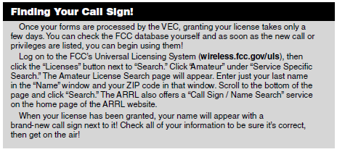
After Examination!

Slide 9
Your Responsibilities
The FCC requires you to provide and maintain a valid current mailing and email address in their database at all times
  Your license can be suspended or revoked and removed from the database
You are obligated to make your station available for inspection upon request by an FCC representative
  Keep your original license available for inspection

Slide 10
Bands and Privileges
There are hundreds of bands and dozens of different types of radio spectrum users
The frequency privileges granted to the various services are called allocations
Most common bands used by Technicians …
  6 meters (50 – 54 MHz)
  2 meters (144 – 148 MHz)
  70 cm (420 – 450 MHz)
  See Table 7.2, Table 7.3, and Figure 7.3 in your text
Technician privileges at …
  http://www.arrl.org/files/file/Tech%20Band%20Chart/US%20Amateur%20Radio%20Technician%20Privileges.pdf

Slide 11
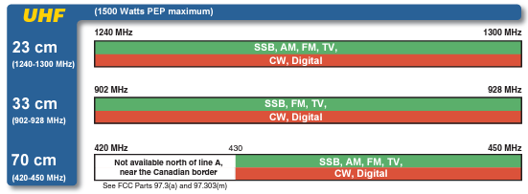
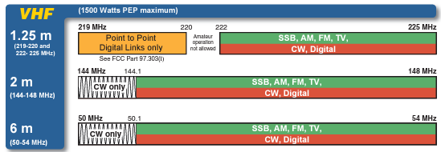
Technician Privileges

Slide 12
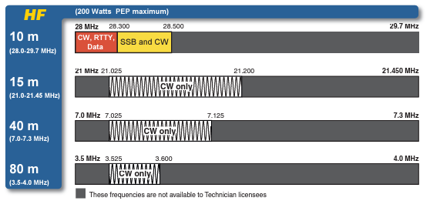
Technician Privileges (cont.)

Slide 13
Emission Privileges
Emission is the formal name for any radio signal from a transmitter
An emission privilege is permission to communicate using a particular mode (phone, CW, data, image, etc.)
Beacons are found on 10 meters between 28.2 and 28.3 MHz and in the lower segments of the VHF, UHF, and microwave bands

Slide 14
Power Limits
Output power from a transmitter or amplifier is defined in terms of peak envelope power (PEP)
Amateurs are allowed the full legal limit of 1500 watts PEP output (some exceptions)
Below 30 MHz, Novice and Technician licensees are limited to 200 watts PEP on HF bands

Slide 15
Primary and Secondary Allocations
Many amateur bands are exclusively allocated to hams
Occasionally two services receive shared allocations (even ham bands)
  One group is generally given priority … called primary allocation
  Lower priority is called secondary allocation
The primary service is protected from harmful interference by signals from secondary services
  For example, amateurs have a secondary allocation in the 70 cm band and must avoid interfering with radiolocation stations that have primary status
Part 97.303 lists all of the frequency-sharing requirements for US hams (see www.arrl.org)

Slide 16
Repeater Coordination (includes Auxiliary Stations)
Hams have developed a system of regional frequency coordination to ensure that repeaters use amateur bands wisely and avoid interference to the greatest degree possible (not FCC controlled)
Repeaters’ input and output frequency pairs are fixed and have a common offset in each region
A committee of volunteers known as a frequency coordinator recommends transmit and receive frequencies
Frequency coordinator representatives are selected by local or regional amateurs whose stations are eligible to be repeater stations
Uncoordinated repeaters are strongly discouraged because they often cause interference

Slide 17
International Rules
Every country has its equivalent agency to the FCC
The International Telecommunication Union (ITU) coordinates allocations across international borders
The ITU divides the world into the three regions … US is region 2 (except for some territories in the Pacific … region 3)
Unless specifically prohibited by the government of either country, any ham can talk to any other ham
  International communications must be limited to the purposes of the amateur service or remarks of a personal nature
The FCC can prohibit contacts between US citizens and those of specific other countries by notifying the ITU of its objections (uncommon!)

Slide 18
International Operating
The foreign country must permit amateur operation (some don’t)
You must have permission when you are inside a country’s national boundaries (and territorial waters)
  You are required to operate according to their rules
You may also operate from any vessel or craft that is documented or registered in the United States
  If the vessel is in territorial waters, regulations of the host country and those of the vessel’s registry both apply

Slide 19
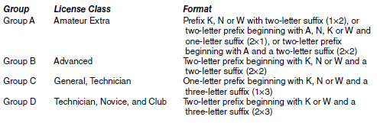
Call Signs
Amateur call signs have a prefix and suffix
  Prefix: One or two letters and one numeral
  Suffix: One to three letters
Technician class license holders may choose their own vanity call sign (from Groups C or D)
US Amateur Call Sign Formats

Slide 20
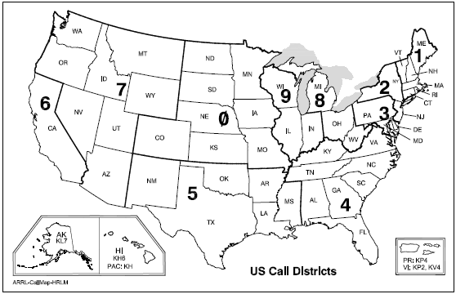
US Call Districts
You are assigned the numeral part of your call by the FCC, based upon where you live. If you move, this number stays with you. HOWEVER, you may request (and obtain) a vanity call outside your district!

Slide 21
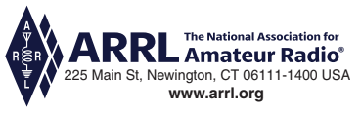
END OF MODULE 7

